Slide 1
ORGANIZERS
SCIENTIFIC COMMITTEE
STEFANO PINI
SW Developer - AiLux
Use of the IEC 60870-5-104 protocol in the remote control and management of oil and gas plants, a real case
IVS 2022
Technical Conference

Slide 2
Biography – Stefano Pini
UniBS - Electronic Engineering
Started my career in AiLux almost 10 yeas ago
Monitoring systems for oil & gas and electrical substation
Development of network protocols on RTUs
Member of IEC 62351 TC57 – WG15

Slide 3
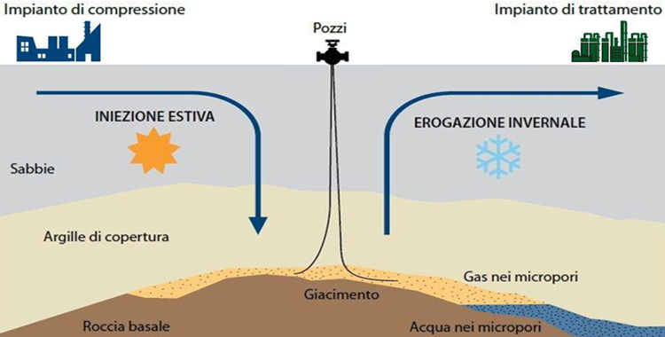
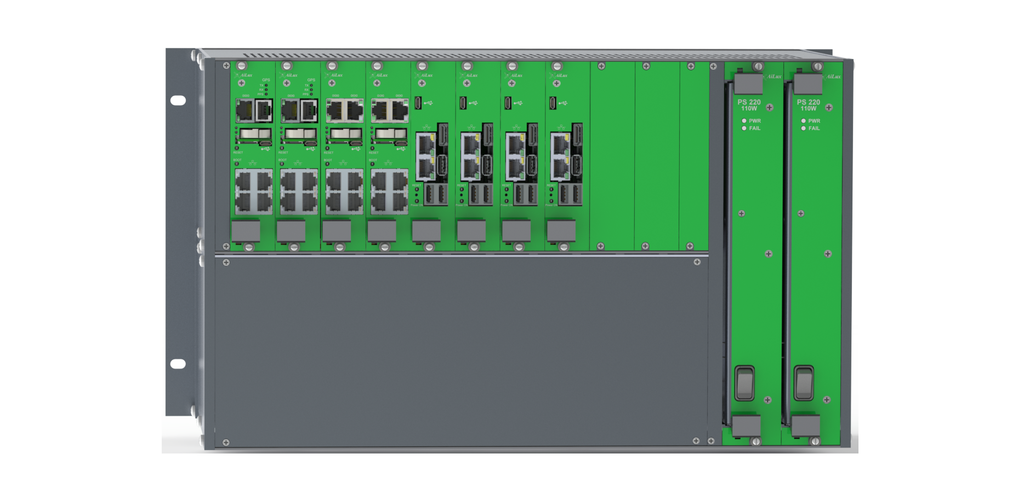
Use case: remote control of a Gas Storage Plant
The goals of the project with the new devices are:
Revamping of the remote control equipment of the gas storage plant (RTU and SCADA)
Improved reliability in the data exchanged.
Improved configuration and self-diagnostic
IT security
SCADA

Slide 4
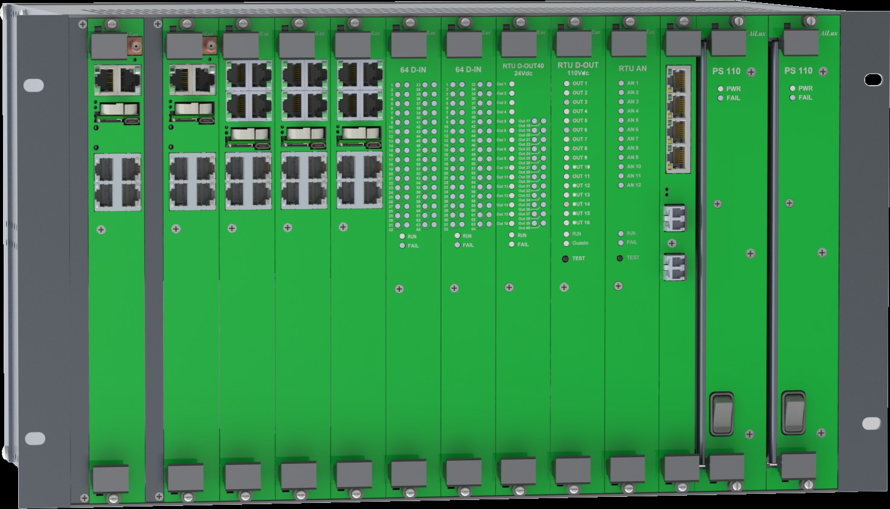
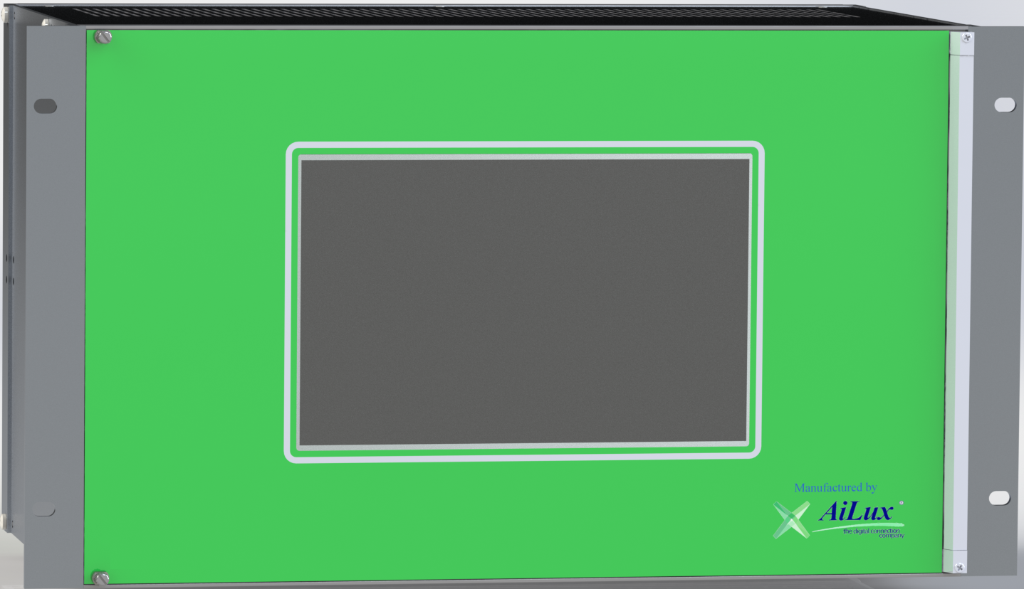
Device used for remote control of a Gas Storage Plant
CPU with Ethernet Redundancy (4 Ethernet ports)
CPU Redundancy – Hot Swap
CPU with RS232 & RS485
Time Synchronization (IEEE 1588 – Precision Time Protocol)
Power Supply Redundancy
Modularity – In each rack is possible to insert CPU, DI, DO, AI and AO Boards
The Main Rack can be expanded if connected to other Racks – HSR

Slide 5
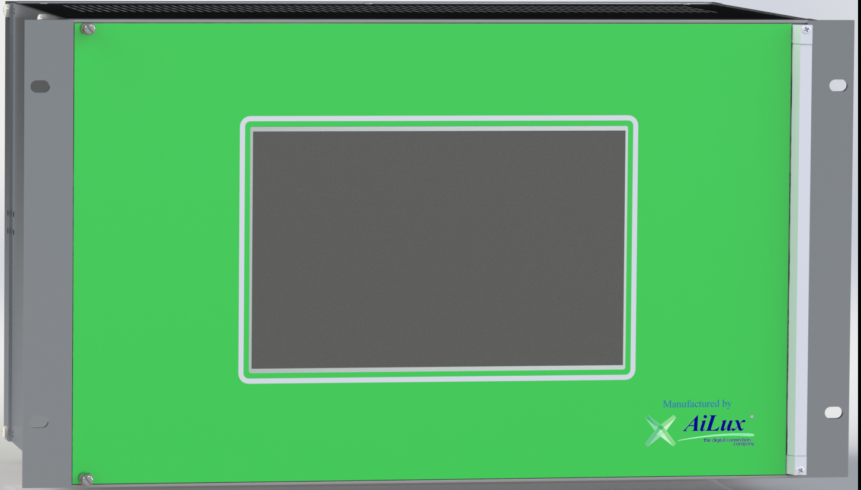
Device used for remote control of a Gas Storage Plant
SCADA
Field
Power Supply

Slide 6
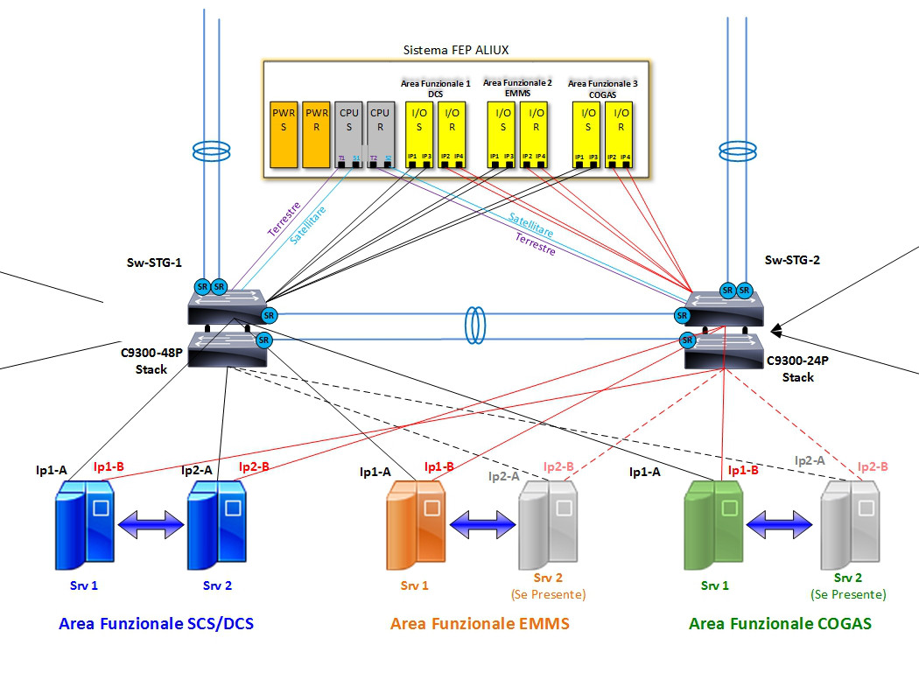
Plant Architecture
The system has been designed without a Single Point of Failure.
Anything that might be affected by a breakdown has a replacement ready to dynamically replace it.

Slide 7
SCADA communicaton: IEC 60870-5-104 - overview
This network protocol has been designed for the remote control in electric substations.
Has been used also in other fields (e.g. oil & gas) due to the main advantages:
Interoperability among different vendors
Support for redundancy
Data and measures from Controlled Stations to Master Station
Commands from Master Station to Controlled Stations
Reliable data (CRC / checksum)
Low Bandwith required (Minimized protocol overhead)
Timestamps
Time synchronization

Slide 8
SCADA communicaton: IEC 62351 a secure version
of IEC 60870-5-104
IEC Technical Committee 57 – Working Group 15 has been in charge of the security of this protocol (and others).
E2E security by design.
New features:
Confidentiality
Mutual Authentication (User/Device Certificates)
Authenticity
Integrity
Role Based Access Control
Public Key Infrastructure
Device enrollment

Slide 9
Field Communication Protocols
The communication with the field equipment is made with this protocols:
OPC-UA
OPC-DA
LonWorks
ModBus-RTU, ModBus-TCP/IP Master & Slave
IEC 60870-5-104 Master/Slave/Reverse/Redundancy + 101 and 103
IEC 61850 Client / Goose & Server
C37.118 Client or Server
IEC 62056-21 (DLMS)
DNP 3
LoRaWAN

Slide 10
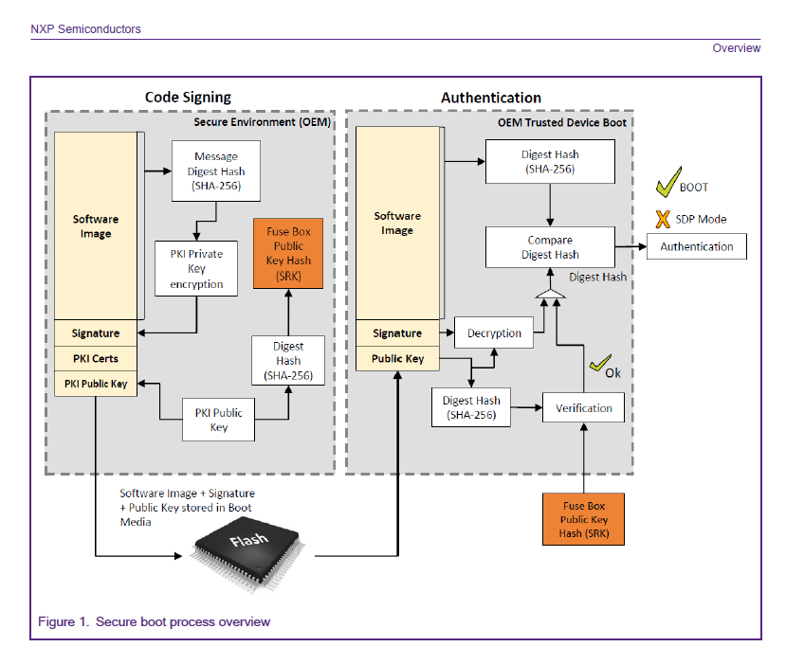
Hardware Cybersecurity
High Assurance Boot:
Secure Boot
Trusted Execution
Cryptographic Accelerators
Tamper Detection
TPM 2.0 – FIPS 140-2 level 3
HW Key Protection
AiLux cyber pack: enhanced OT security

Slide 11
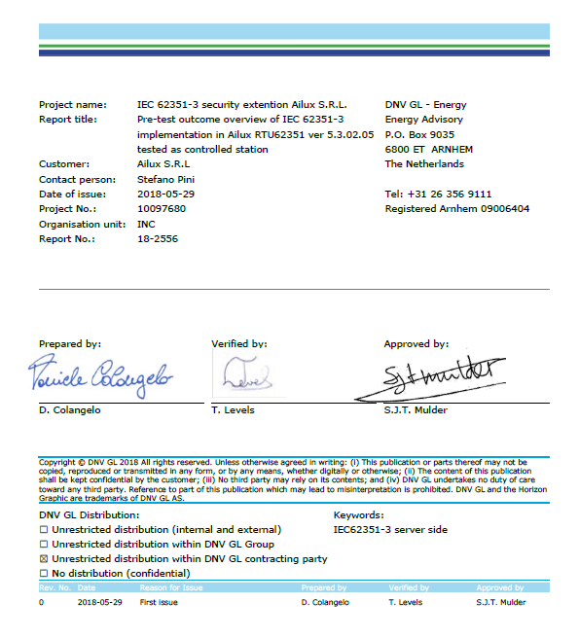
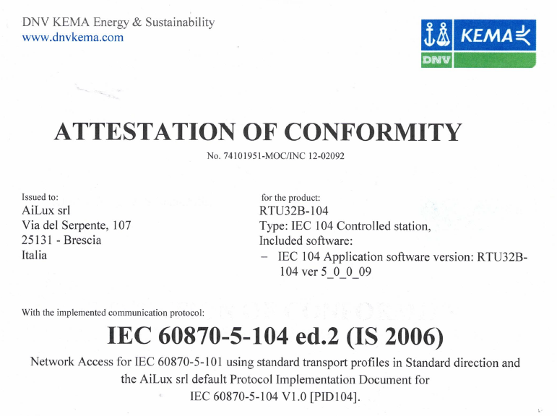
Protocol Certifications
IEC 60870-5-104 ed.2 IEC 62351
IEC 61850 ed.2 in progress

Slide 12
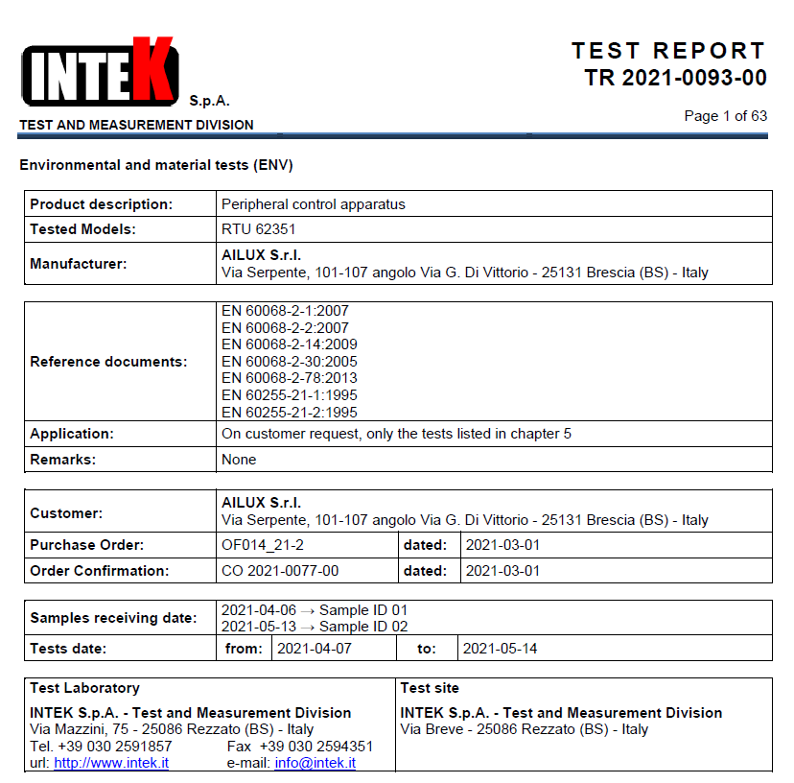
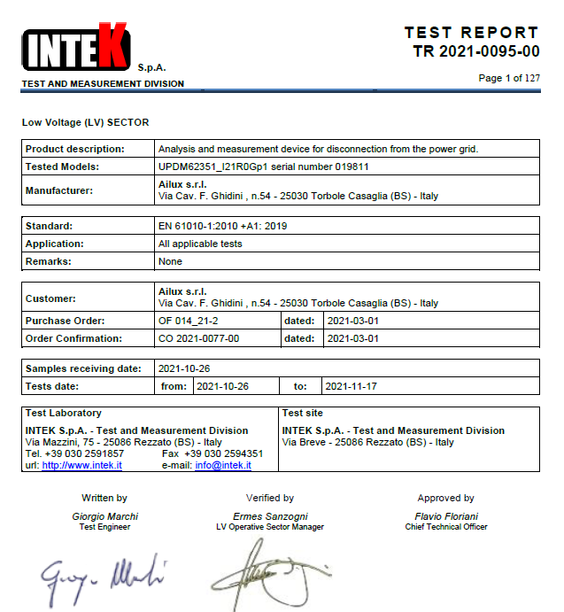
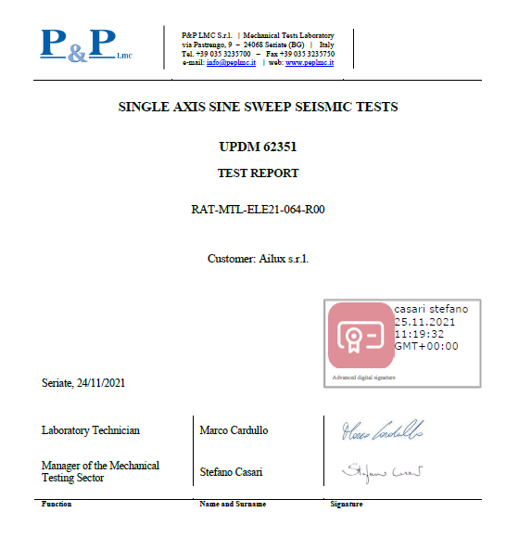
Hardware Certifications
ENVIRONMENTAL & MATERIAL ELECTRICAL SECURITY SEISMIC

Slide 13
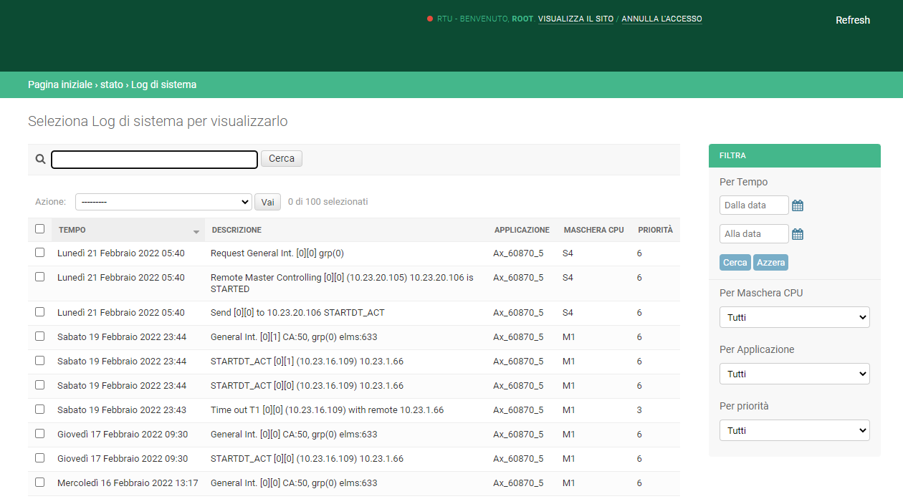
Web Pages
RBAC
Users
Commands
Network Parameters
Protocol Configuration
System Log
RTU Status
Single CPU staus
Value History
Configuration Upload

Slide 14
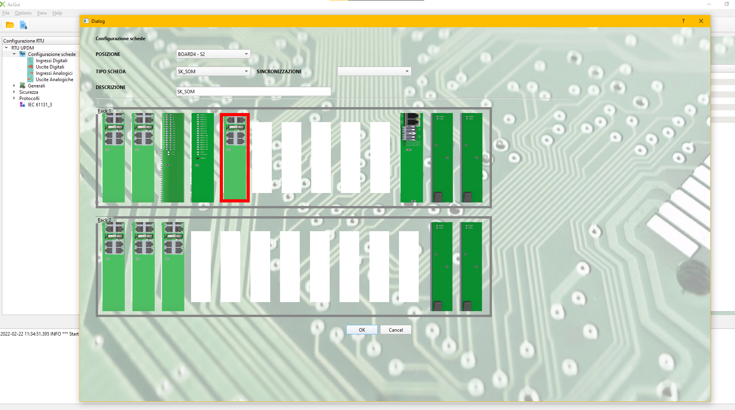
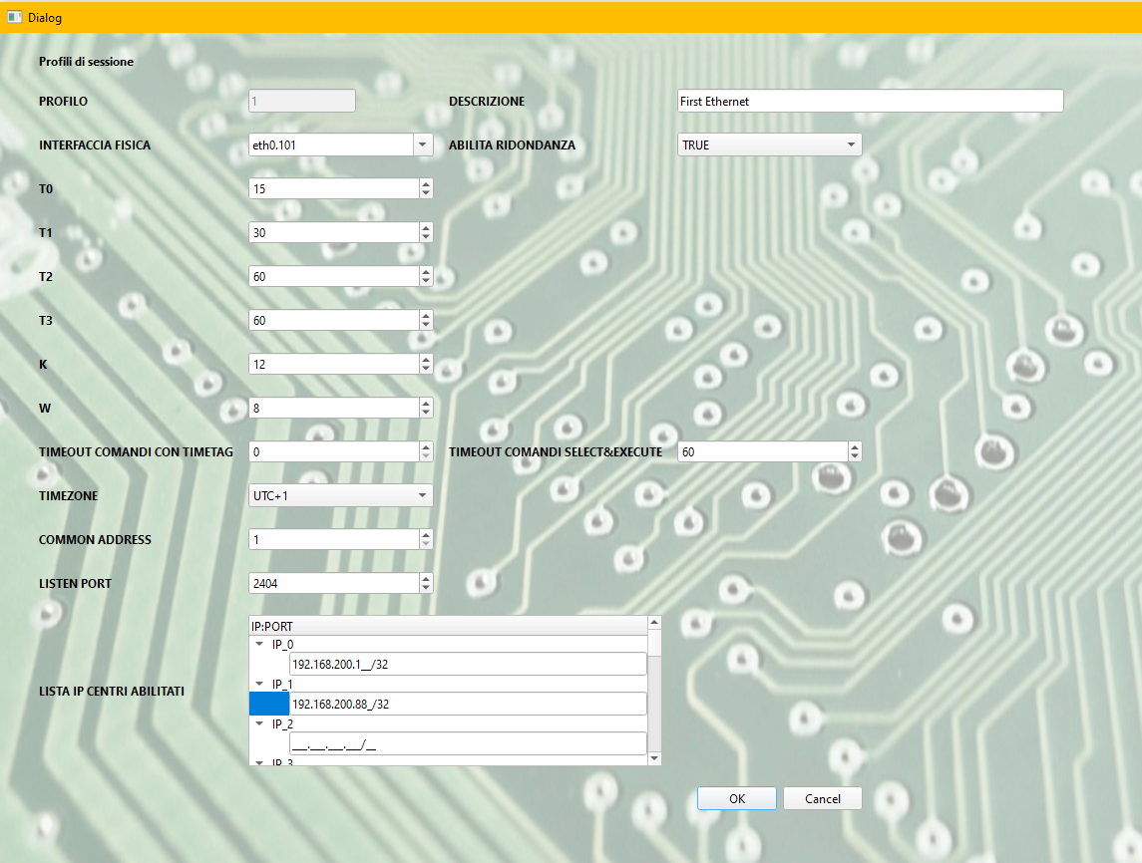
Configuration

Slide 15
ORGANIZERS
SCIENTIFIC COMMITTEE
We wait you for a demo – HALL C stand 97
info@ailux.eu
Q & A SESSION
Thank you for your attention!
IVS 2022
Technical Conference

