Slide 1





Stefano Crippa
ORGANIZERS
SCIENTIFIC COMMITTEE
Tenaris Product Manager • TENARIS Pipeline Technology Division
Tenaris Products for Energy Transition
IVS 2022
Technical Conference

Slide 2
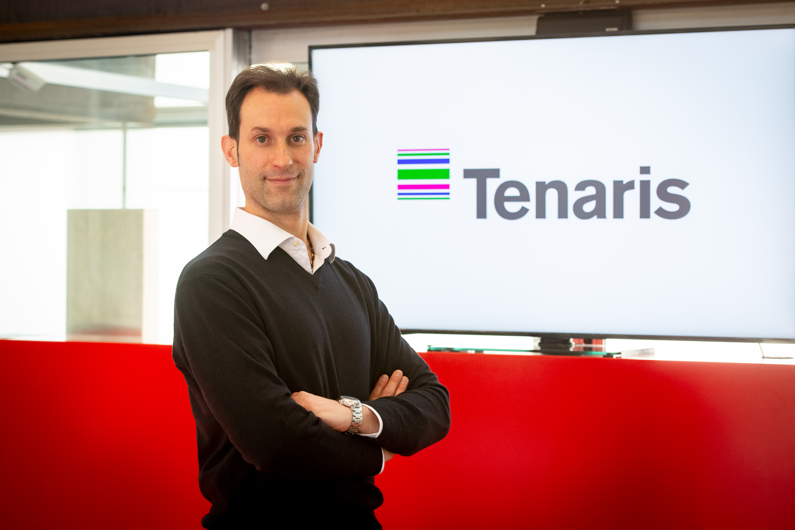
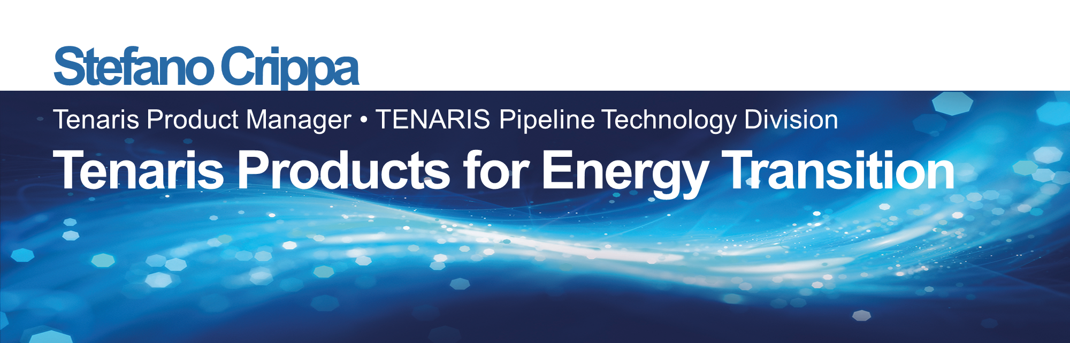
Biography
– Stefano Crippa –
Line Pipe Product Manager for the Pipeline Pipeline Technology Division [Dalmine (BG), Italy]
Academic background: Master Degree in Mechanic Engineering [Politecnico di Milano, Italy]
Working for 14 years in Tenaris, of which 12 years in the current department.
Responsible for analyzing the technical feasibility of the Line Pipe & Bends for Caspian markets. Responsible of the team of engineers analyzing the technical feasibility of the TSH Blue®Riser Connection and providing support to the commercial area in analyzing offerings to meet customer’s quality demands. Develops new special products to meet customers quality demands. 6 Publications in International Journals and Conferences.

Slide 3
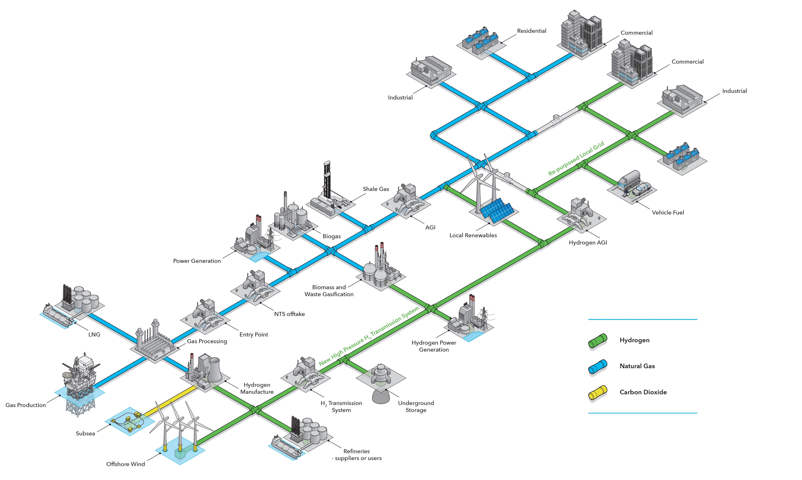
What Everybody Already Know
How it will look like
Source: DNV – Hydrogen - Decarbonising Heat 2020

Slide 4
PATHWAY TO NET ZERO (PNZ)
In order to achieve net zero emissions in 2050, fossil fuel use is reduced about 80% from today, and carbon capture and removal removes a further 8 Gt of CO2 emissions. The 2050 PNZ energy system will be dominated by solar and wind generated electricity, but also sees a strong role for hydrogen in the hard-to-abate sectors.
Source: DNV – DNV_Pathway_to_net-zero_2021

Slide 5
PIPELINES FOR LOW-CARBON GASES
The DNV ETO and the International Energy Agency forecast CCUS demand in 2050 will be roughly 100 times larger than collective capacity of the approximately 6,500 km of CO2 pipelines that exist today.
Key considerations for new and repurposed hydrogen and CO2 pipelines
 | Repurposed | New
CO2 | • The design pressure & temperature of the pipeline (avoiding the two-phase region) • Impurities in the CO2 changing fracture propagation properties • Water dew point in the pipeline. • Dense phase CO2 acting as a solvent (elastomer effects) • Fatigue/cycling effects • Life extension of pipelines • Blowdown/venting provisions • Cleaning/purging of existing lines | • Pipeline routing and permitting. • Operating mode (gaseous, liquid or supercritical) and mass density • Public consultation • Possible cryogenic effects • Pressure maintenance (boosting for long pipelines) • Startup/shutdown impacts • Metering • Pipeline sectioning • Linepipe selection
Source: DNV – Technology_Progress_Report_2021

Slide 6
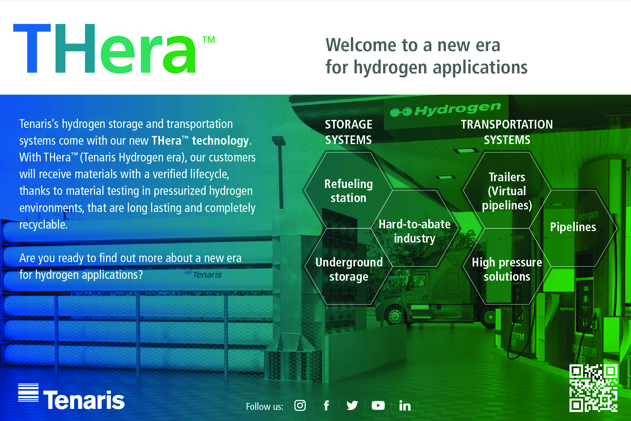
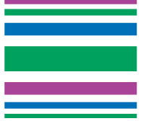
Tenaris Products for Energy Transition
Market introduction
June 2021 (link)
- Official launch -
Article & form to request the document :
October 2021 (link)
Tenaris is introducing THera™, at the Carbon Capture & Hydrogen Technology Expo Europe in Bremen, Germany
December 2021 (link)
THera™, Tenaris Hydrogen era presented at Enlit Europe in Milan

Slide 7
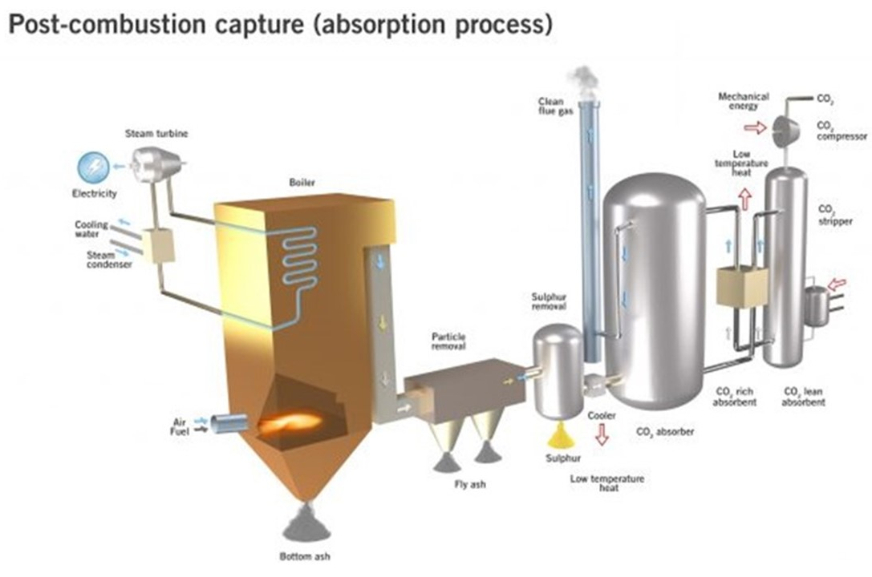
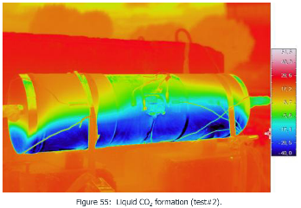
Tenaris Products for Energy Transition
Main pending technical issues
Main pending technical issues :
Corrosion / Effects of impurities: typically generated in power plants, such as SOx, NOx, O2, H2S, and C particulates. The main tread remaining CO2-corrosion (water contamination). Need of Stress Corrosion Cracking and Weight Loss validations.
Joule-Thomson effect and vaporization of CO2 : they occur during shutdowns, start-ups or transient operations, and are mainly critical during depressurizing, release or leakage of CO2, causing cooling of the metal and brittle fracture.
Gaps Related to Equations of State - Running Cracks: Verification of reliable equations of state for supercritical CO2.
Liquide CO2 Leakage

Slide 8
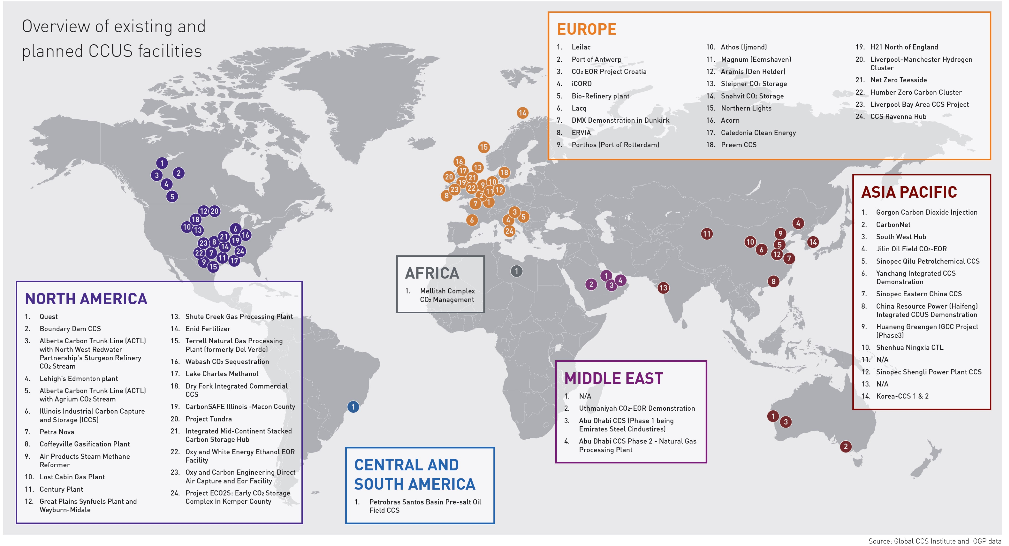
Tenaris Products for Energy Transition
CCS WW Project Overview
CO2 transportation in pipelines for industrial purposes is not new, but is gaining momentum due to global warming and carbon emissions target (>30 projects under development).

Slide 9
Tenaris Products for Energy Transition
CCS EU Project Overview
CO2 transportation in pipelines for industrial purposes is not new, but is gaining momentum due to global warming and carbon emissions target (>30 projects under development).
Source: Global CCS Institute and IOGP Data

Slide 10
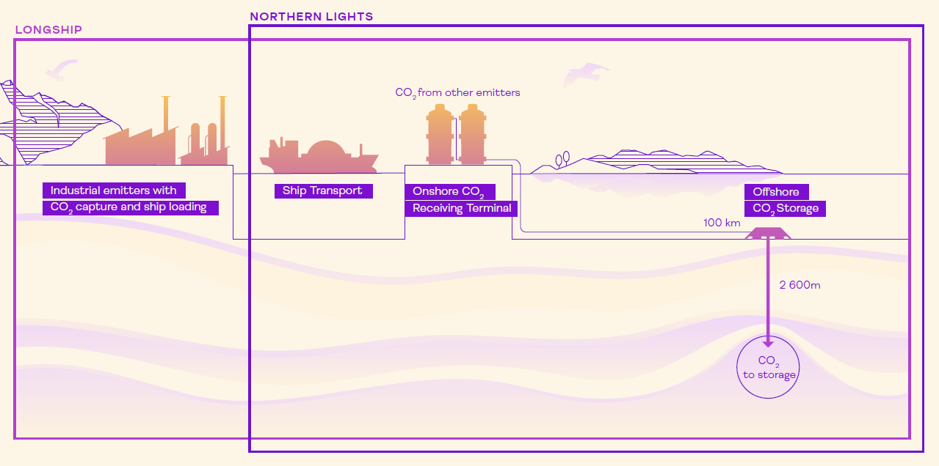
Equinor – Northern Lights CCS
_{FID}
_{PO}
_{Installation}
_{Start-up}
Project Description:
Development of a full-scale CCS facility on the Norwegian Continental Shelf (NCS). The project will compress and store CO2 captured from industrial sites: Fortum Oslo Varme’s waste-to-energy facility in Oslo and Norcem’s cement factory in Brevik. Liquid CO2 will be transported by ship from the capture facilities to a receiving terminal in Øygarden. CO2 will be transferred from the ship to intermediate storage tanks, prior to being sent through a pipeline on the seabed to injection wells for permanent storage in depleted reservoirs.
_{Delivery}
2024
2020
2021
2022
2023
Tenaris Line Pipe scope:
OD: 12’’
Volume: approx. 12,8 ThTn / 105 Km
Material grade: DNVGL SMLS 450 SFPD
Final delivery (bare pipe): by June 2022
Coating: AC coating (EPC responsibility)
Production Mill: Dalmine

Slide 11
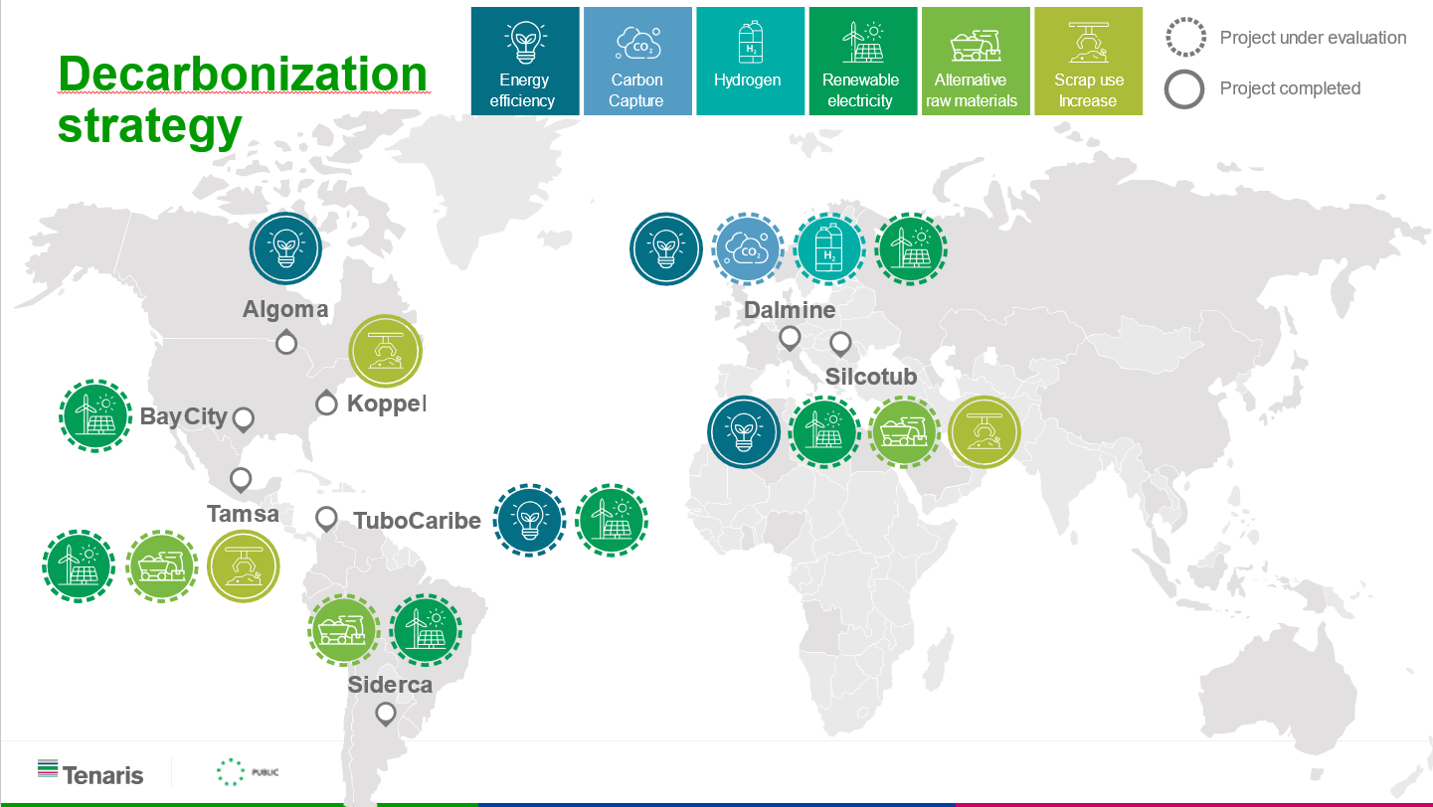
TENARIS

Slide 12
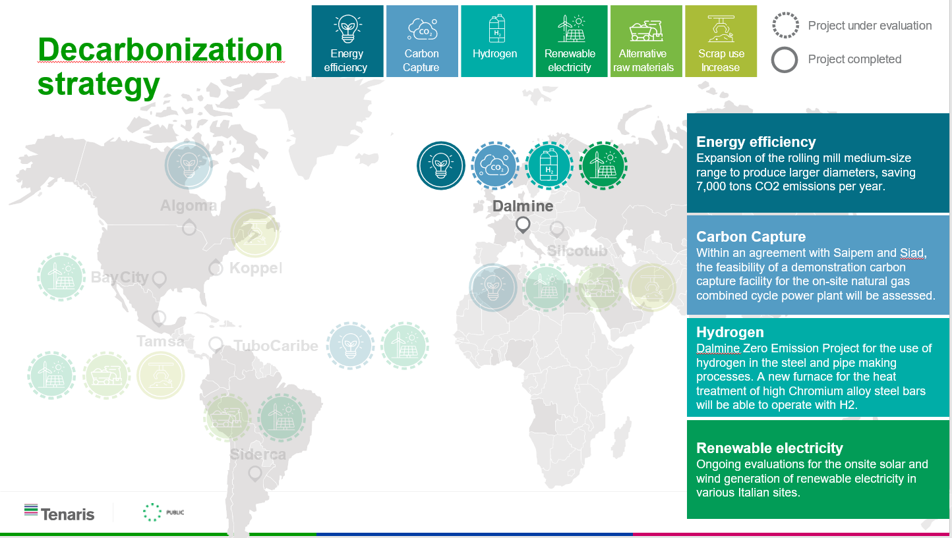
TENARIS

Slide 13

Q & A SESSION
ORGANIZERS
SCIENTIFIC COMMITTEE
Thank you for your attention!
IVS 2022
Technical Conference

