Slide 1
HATIM AL-HAMDAN
ORGANIZERS
SCIENTIFIC COMMITTEE
Chief Office Representative, Inspection | Aramco Europe - Italy
Valves End User Experience
IVS 2022
Technical Conference

Slide 2
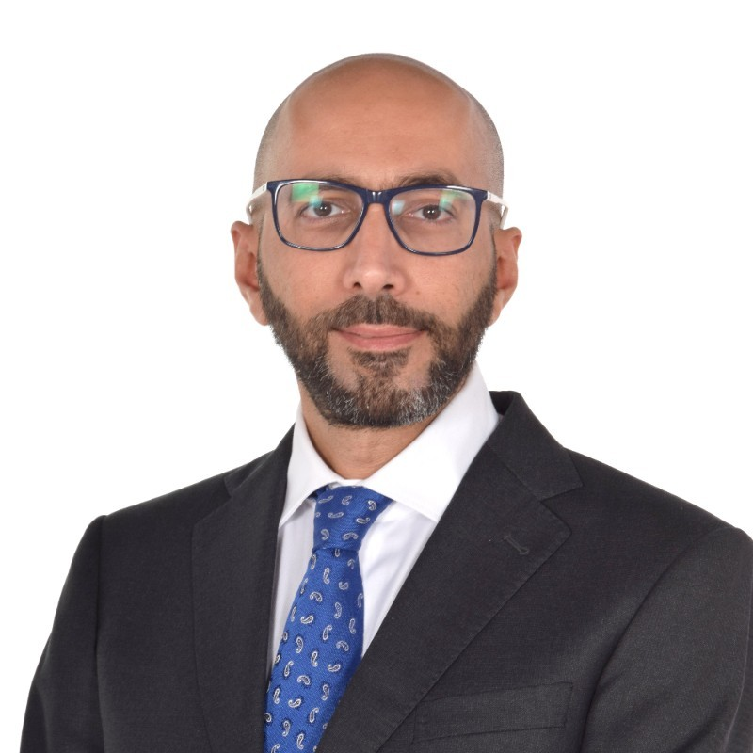
Biography
Hatim Al-Hamdan
Chief Office Representative AOC-Italy, InspectionChief Office Representative AOC-Italy, Inspection
Aramco Overseas Company

Slide 3
Outline
Failed Delivered Valves Statistics
Distribution of Identified Cases
Common Root Causes
Importance of valves integrity
Conclusion & Recommendations

Slide 4
Failed Delivered Valves Statistics (2007-2017)

Slide 5
Distribution of Identified Cases (2007 till 2017)

Slide 6
Failed Delivered Valves Statistics (2018-2021)

Slide 7
Distribution of Identified Cases (2018 till 2021)

Slide 8
Distribution per Defect Type

Slide 9
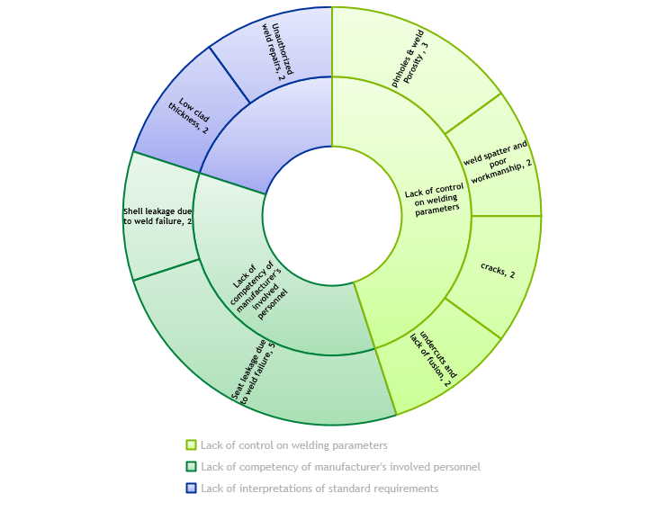
Common Root Causes

Slide 10
Valves – A Highly Critical Equipment
70% of deviations, rejections, NCRs and EDRs from valves
Valves procured by Aramco are mainly used in hazardous hydrocarbons applications
Defective valve can hold the commissioning of a whole Project or can stop the operations of an entire plant, with daily financial impact incomparable with the valve commercial value
The effects of such failures cannot be usually compensated after the fact

Slide 11
Conclusion & Recommendations
Thorough review and good understanding of International and Customer’s requirements
Clarify PO requirements with customer prior to order acknowledgement
Ensure robust end-to-end Design process to include alignment of manufacturing documentation (welding map, drawings, welding procedures, etc.) with the PO and Specification requirements
Regular verification of personnel competency
Set a clear instruction for handling (welding) imperfections and defects
Perform thorough qualification and extensive control when welding activities are outsourced
Identify critical processes and implement relevant quality check by the operators and QC personnel
Remember that the role of customer’s inspector is not to substitute the internal Quality Control and manufacturer is ultimately responsible for the full compliance with applicable requirements

Slide 12
Q & A SESSION
ORGANIZERS
SCIENTIFIC COMMITTEE
Thank you for your attention!
IVS 2022
Technical Conference

