Slide 1





RICHARD BAARS
ORGANIZERS
SCIENTIFIC COMMITTEE
Managing Director - Vmatch
How smart industrial companies can unlock productivity safety with augmented reality
IVS 2022
Technical Conference

Slide 2
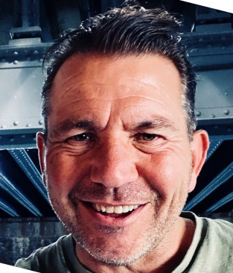
Biography
Richard Baars
Managing Director - Vmatch

Slide 3
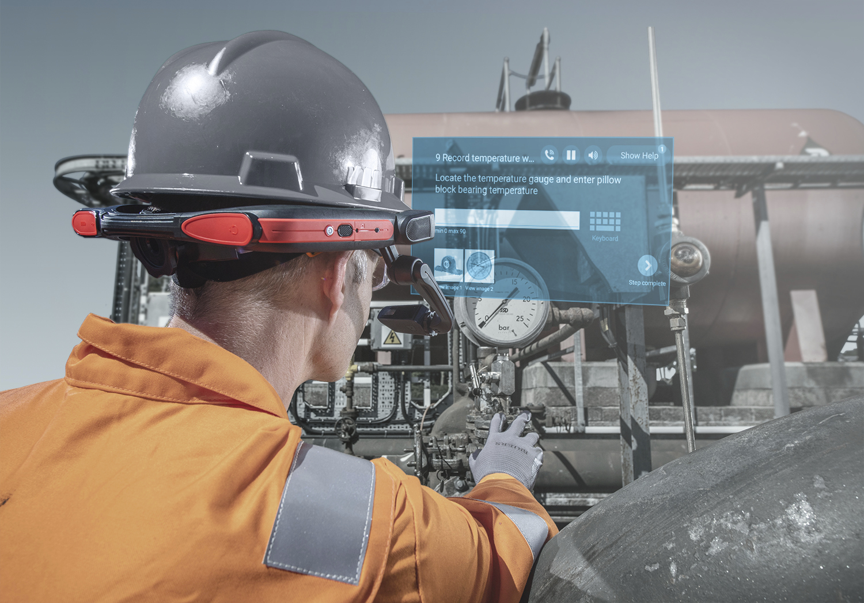
How smart industrial companies can unlock productivity and safety with extended reality
An interactive learning about:
Remote inspection
Real-time expert guidance
Training & knowledge transfer
Digital Workflows
Visualize IIoT data
Smart Wearables
...and many more

Slide 4

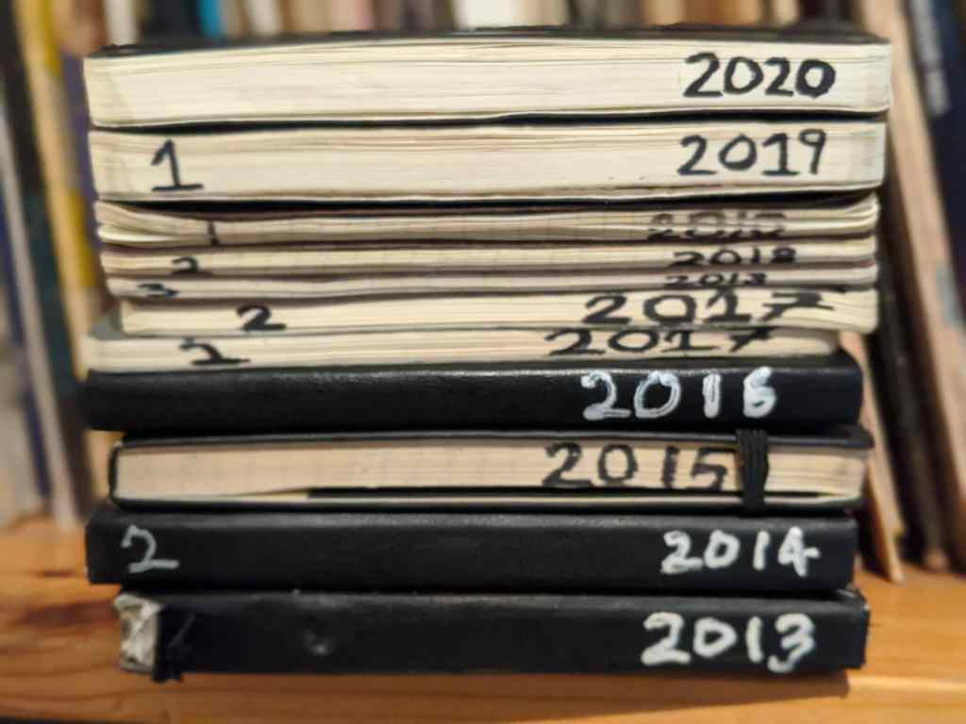
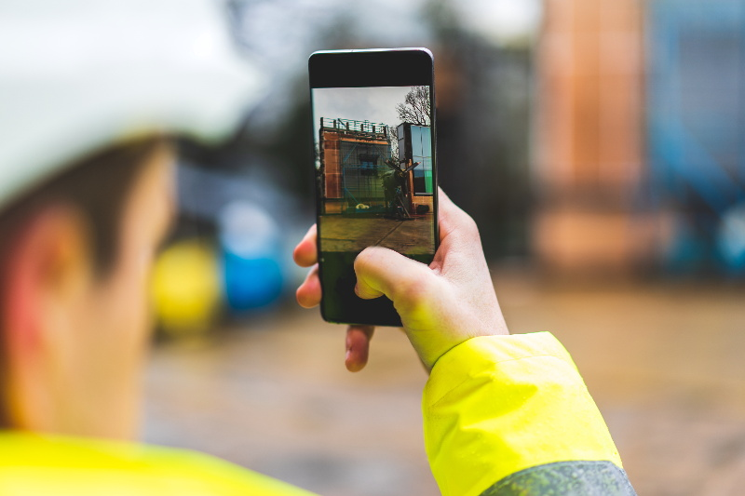
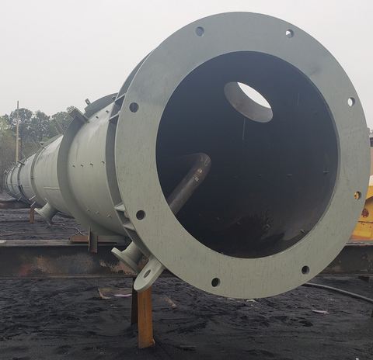
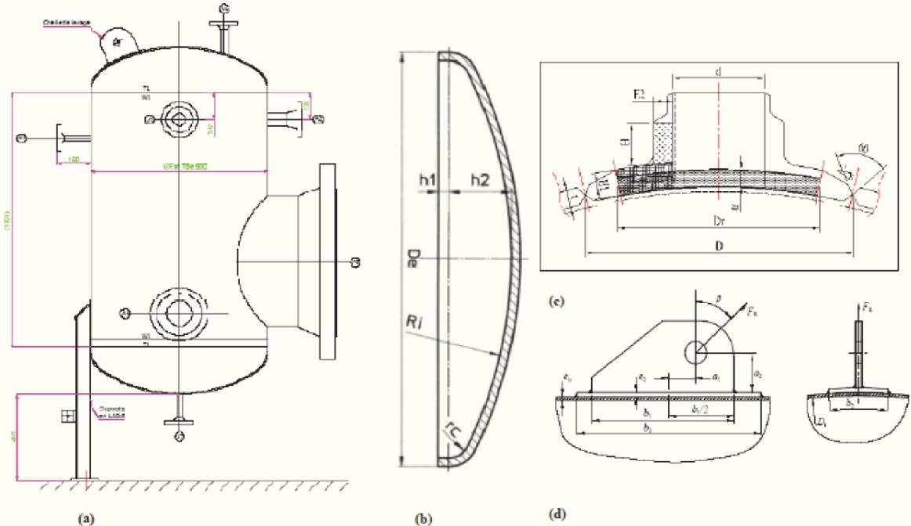
I’M
A
SENIOR SURVEYOR
WHAT’S YOUR SUPERPOWER?
29 maart 2022 (08.00 uur)
Klant: Chemiecorp
Contact: Peter de Leeuw
Inspectie: propaangastank
Lasreparatie controleren
(controle PQR/WQR)
Punchlist:
Tagplate vervangen (onleesbaar)
Coating gecontroleerd op beschadigingen
Afsluiters gecontroleerd

Slide 5












Digital Reality Changes Everything
Embrace the future
Remote-Friendly vs Remote-First

Slide 6
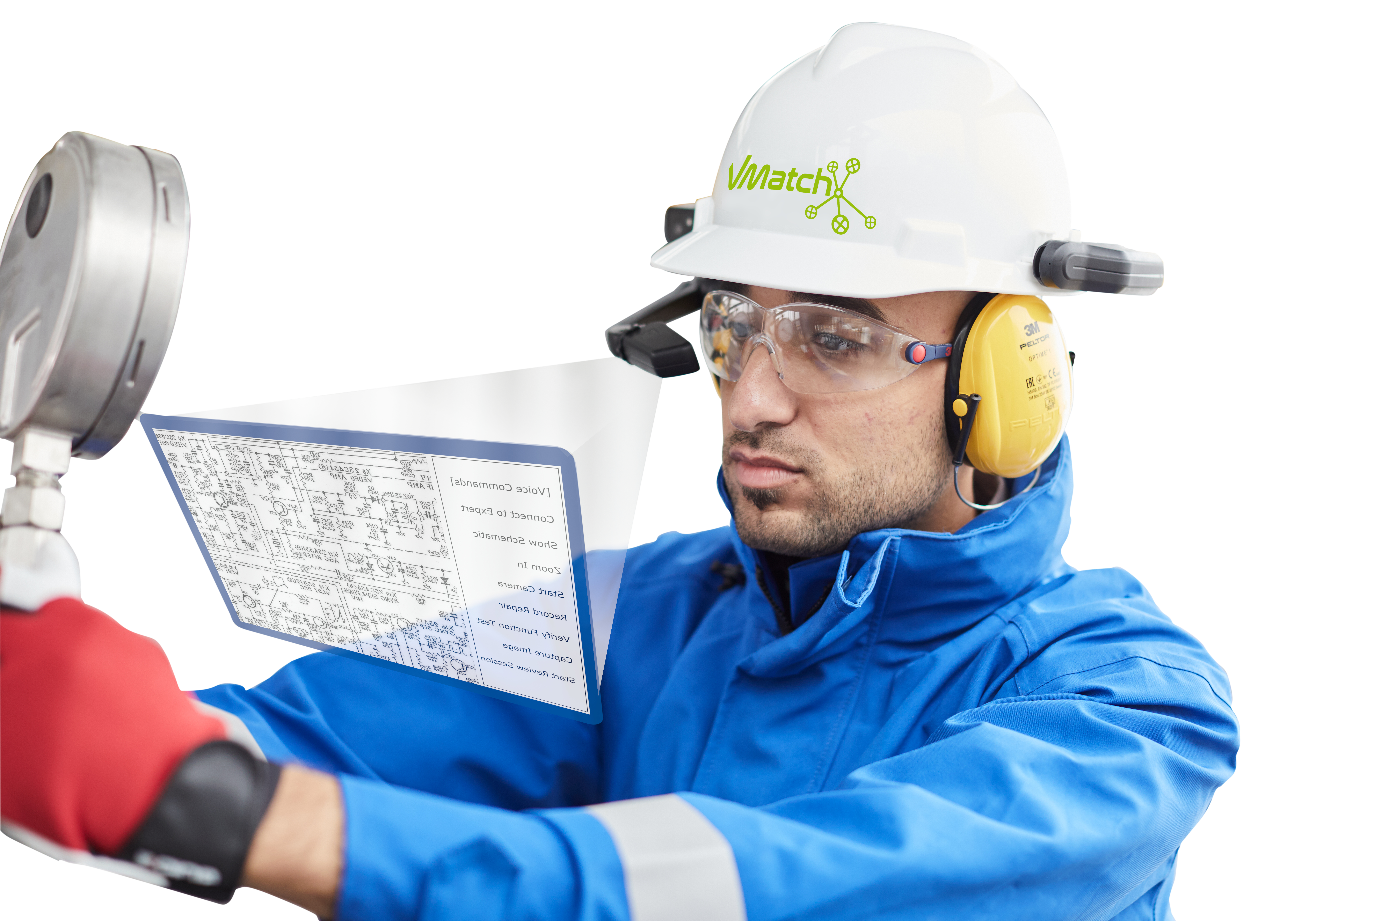
Shaping the future
“Remote inspections using augmented and assisted reality are becoming a key element of the testing, inspection and certification sector”

Slide 7
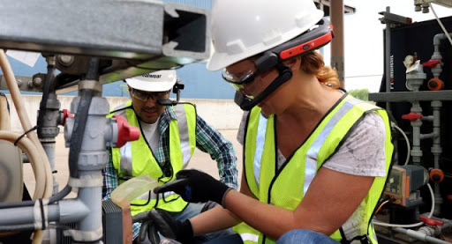
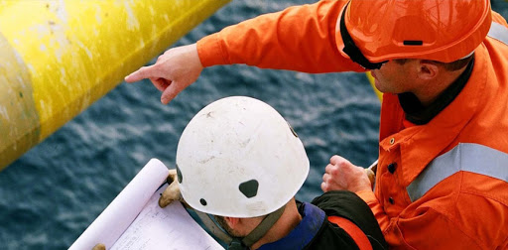
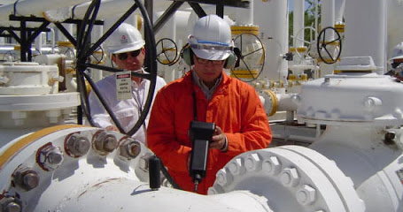
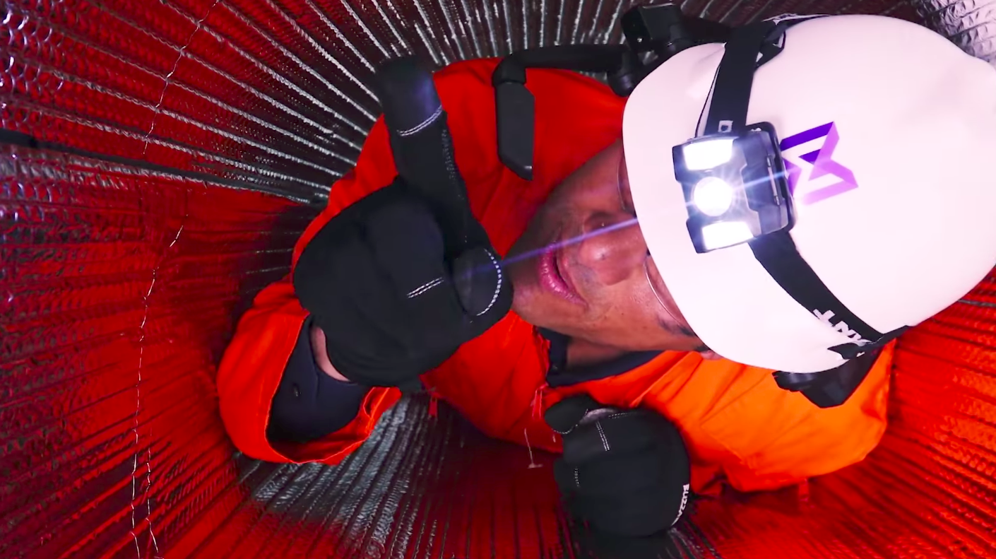
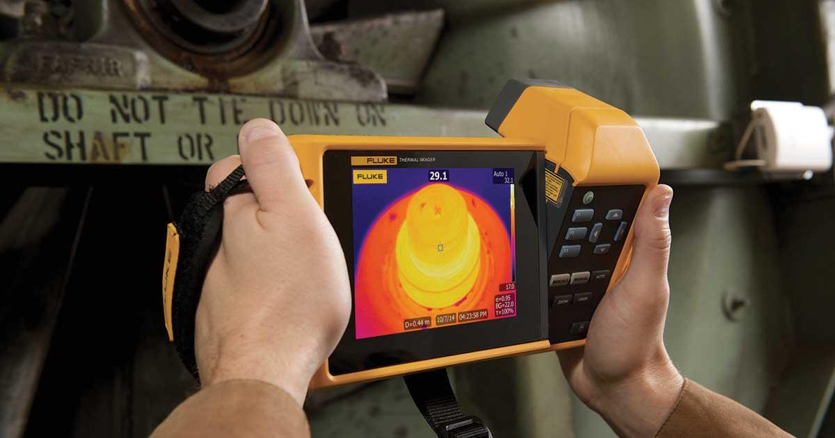
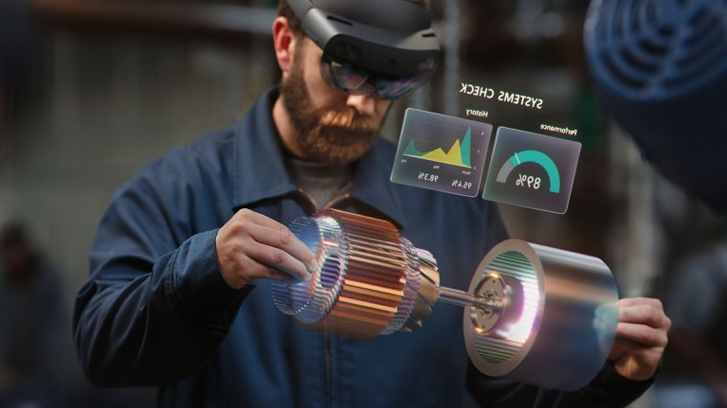
Industry Service Applications
Field Service, Inspection & Assistance
3rd Party Monitoring
OEM Production Testing & Inspection
Confined Spaces Inspection
Infrared (IR) Thermographic Inspection
Quality Assurance, Education & Training
  Factory Acceptance Test (FAT), Inspection Test Plan (ITP), Design Validation Test (DVT), Fabrication & Welding Inspection

Slide 8
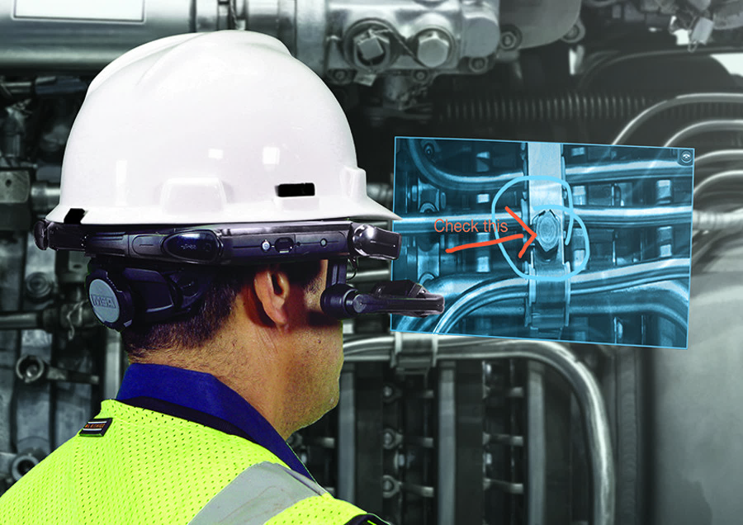
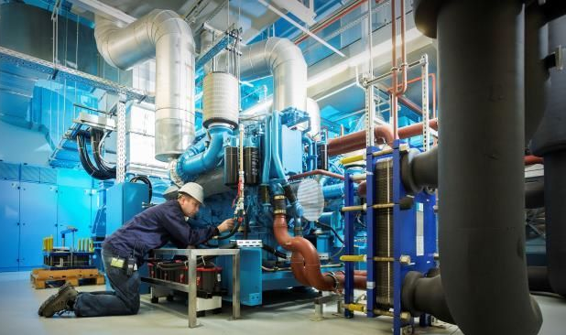
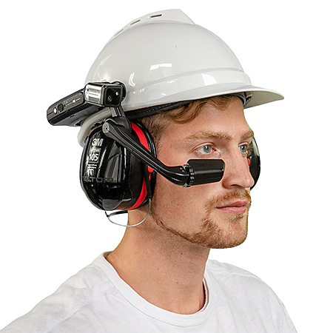
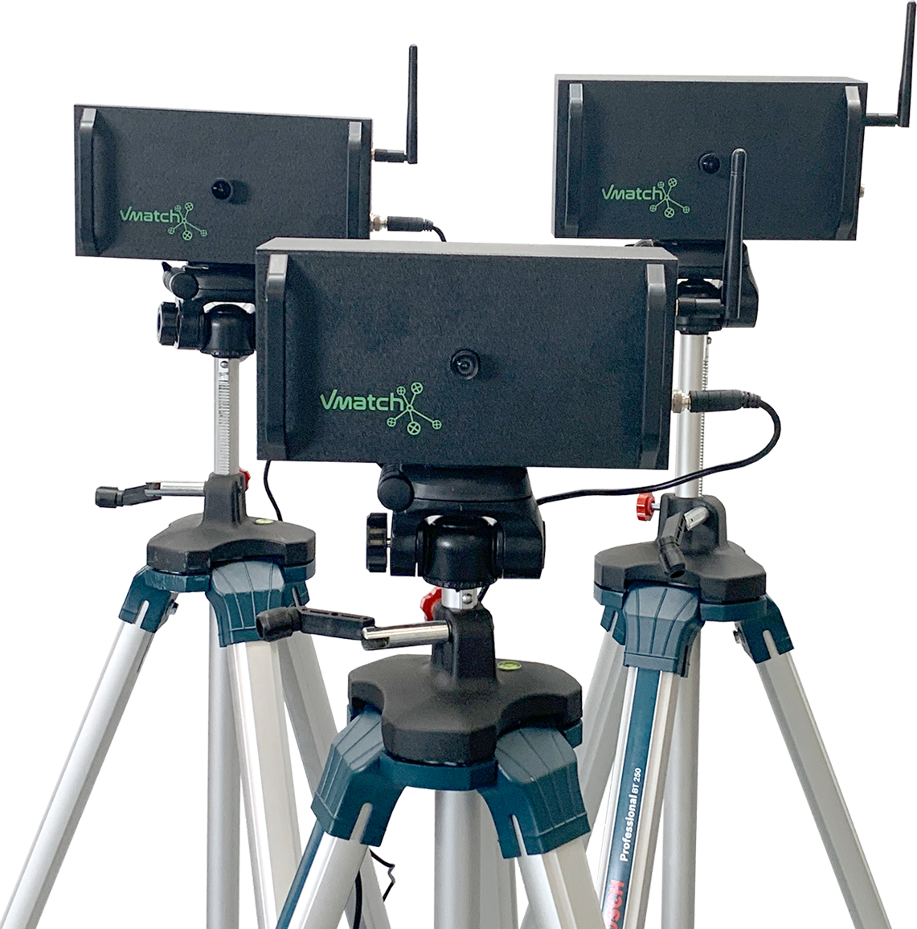
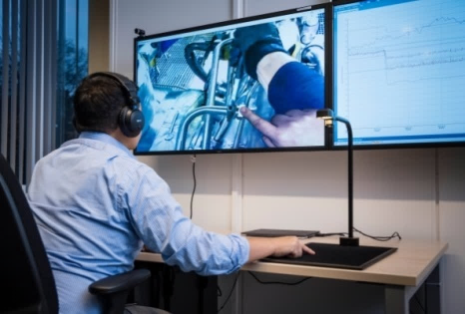

Use Case #1– Field Services, Inspections & Expert Knowledge
Improved first-time fix rates
Faster speed to resolution
Decreased downtime
Increased productivity
Lower operational expenses
Faster time to productivity

Slide 9
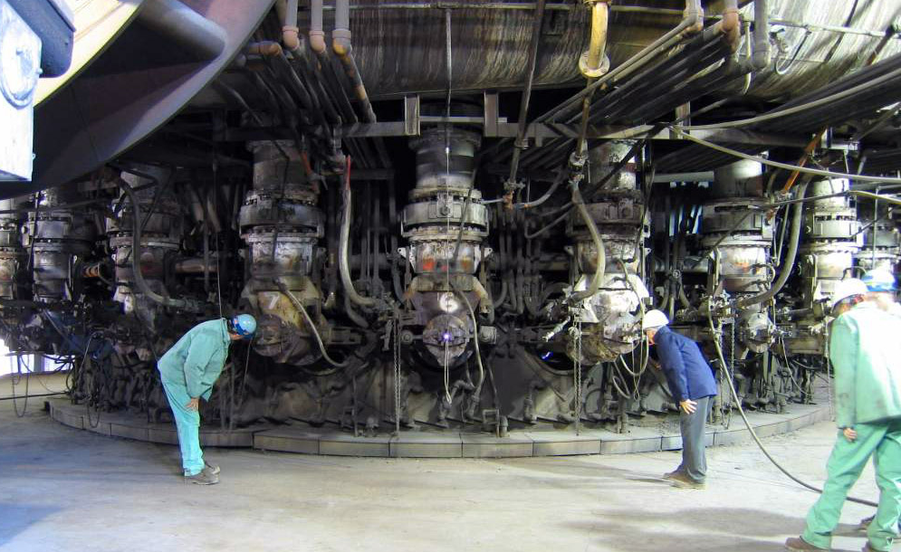
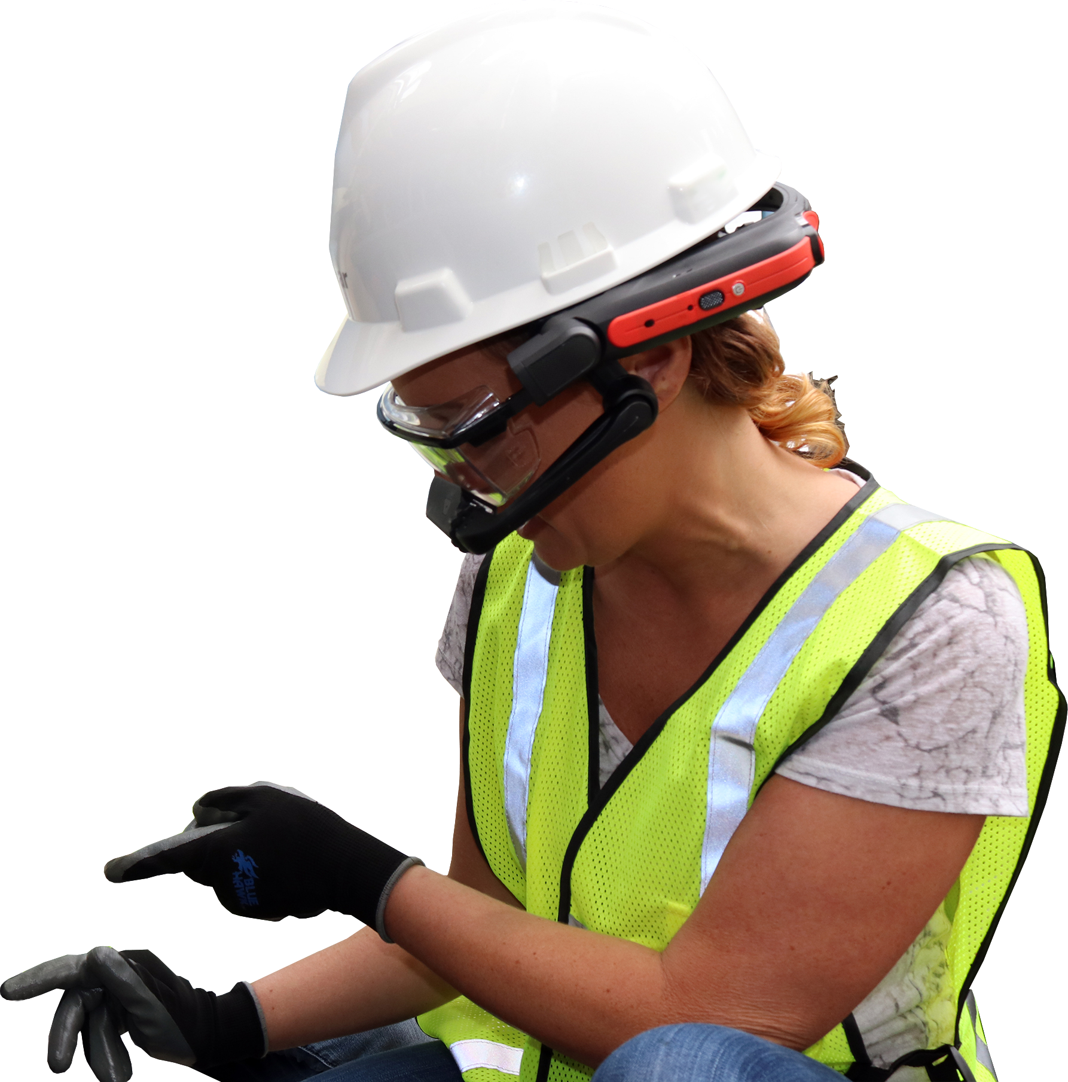
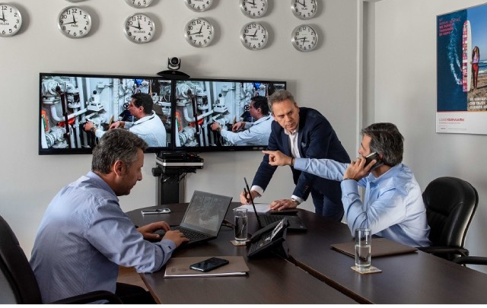
Use Case #2 – Preventive Maintenance & Inspection (ATEX zone)
Improved first-time fix rates
Faster speed to resolution
Decreased downtime
Increased productivity
Lower operational expenses
Faster time to productivity

Slide 10
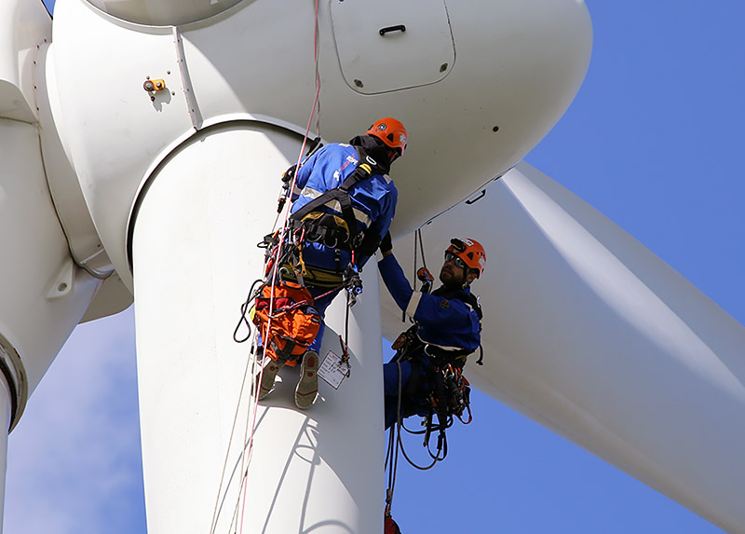

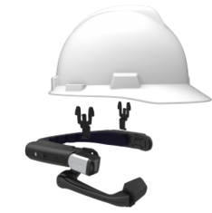
Use Case #3 – Complex Environments
Give field workers the ability to communicate with remote experts in increasingly complex environments
Increased workers safety, productivity & operational efficiency
Unlocking major cost savings & environmental impacts

Slide 11
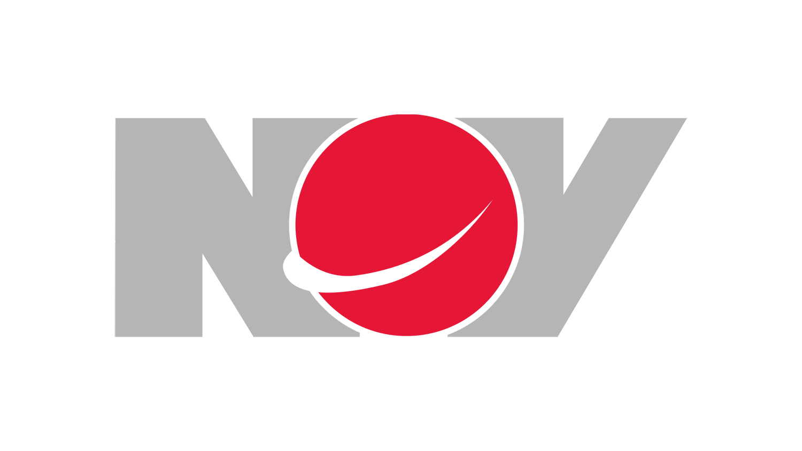

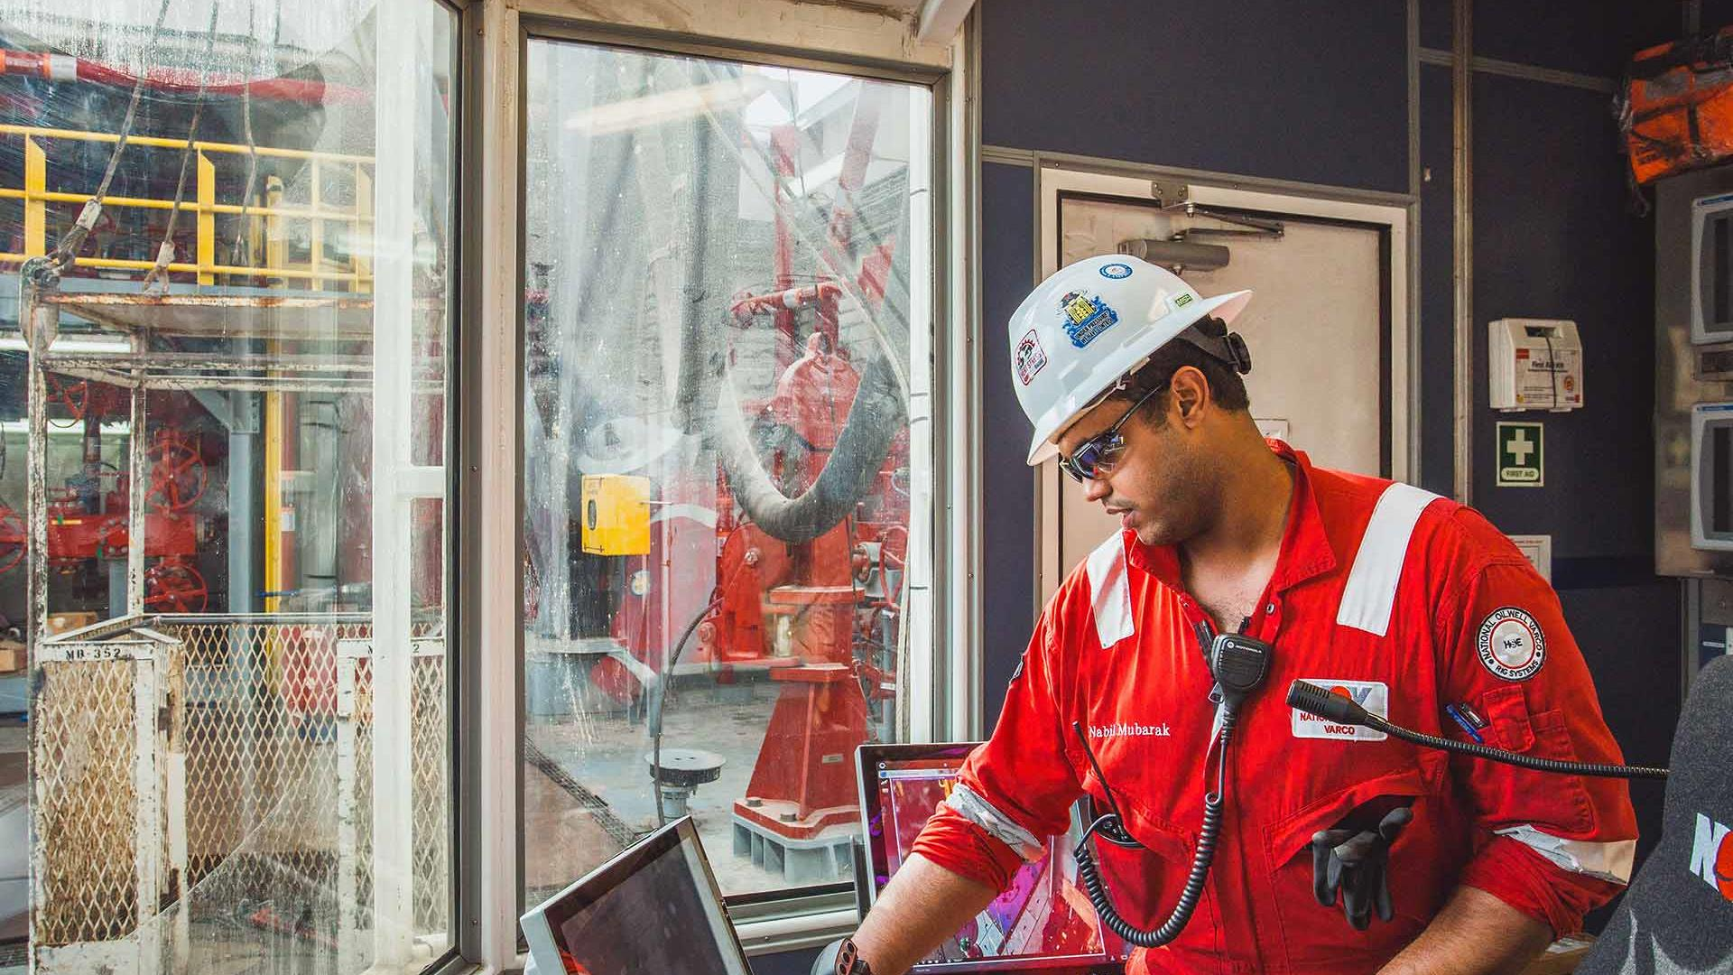
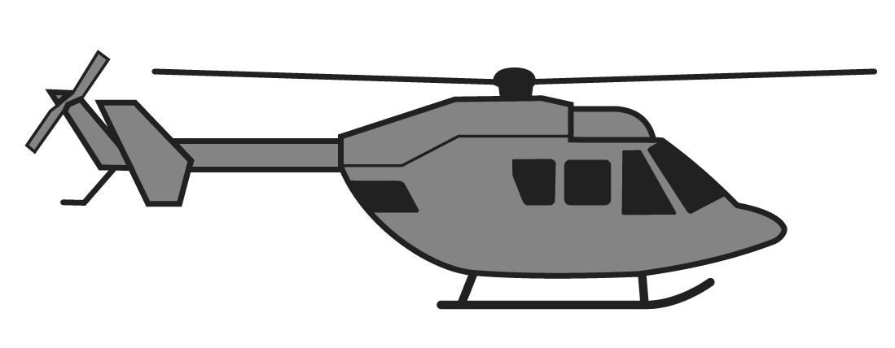
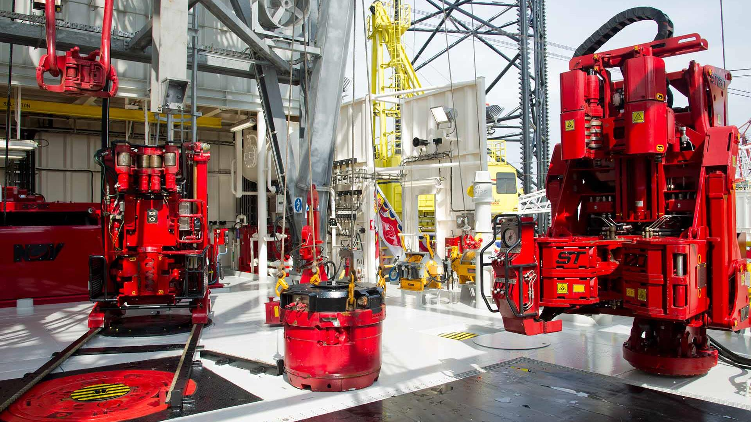

Use Case #4 – Offshore
Reduce risks, downtime & costs
Challenge
Equipment on offshore drilling vessels requires expert support
High cost of downtime for drill pipe welding machines
Skilled workforce is retiring in the next 5 years – reduced number of SMEs to travel offshore
Time lag to communicate with shore-based support staff and customer time pressure increases safety risks
Solution
Workforce multiplier for senior SMEs – offshore travel not required
Remote video enables small group of centralized senior SMEs to mentor many junior field technicians who gradually learn on the job
Inexperienced techs still perform quickly and safely
Content captured for training and reference
Hands free and compatible with specific PPE
Intrinsically safe wearable device
OFFSHORE DRILLING VESSEL SUPPORT

Slide 12
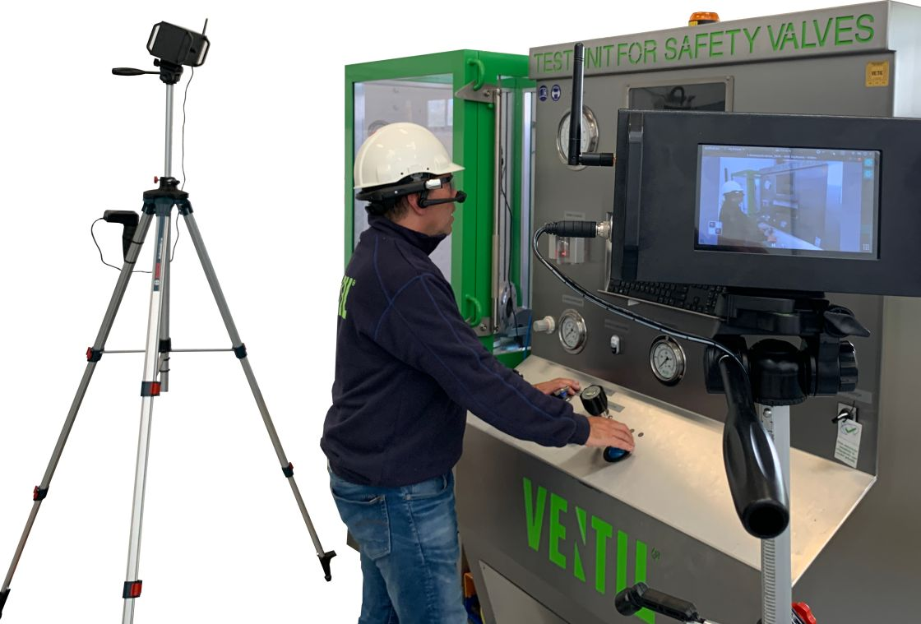
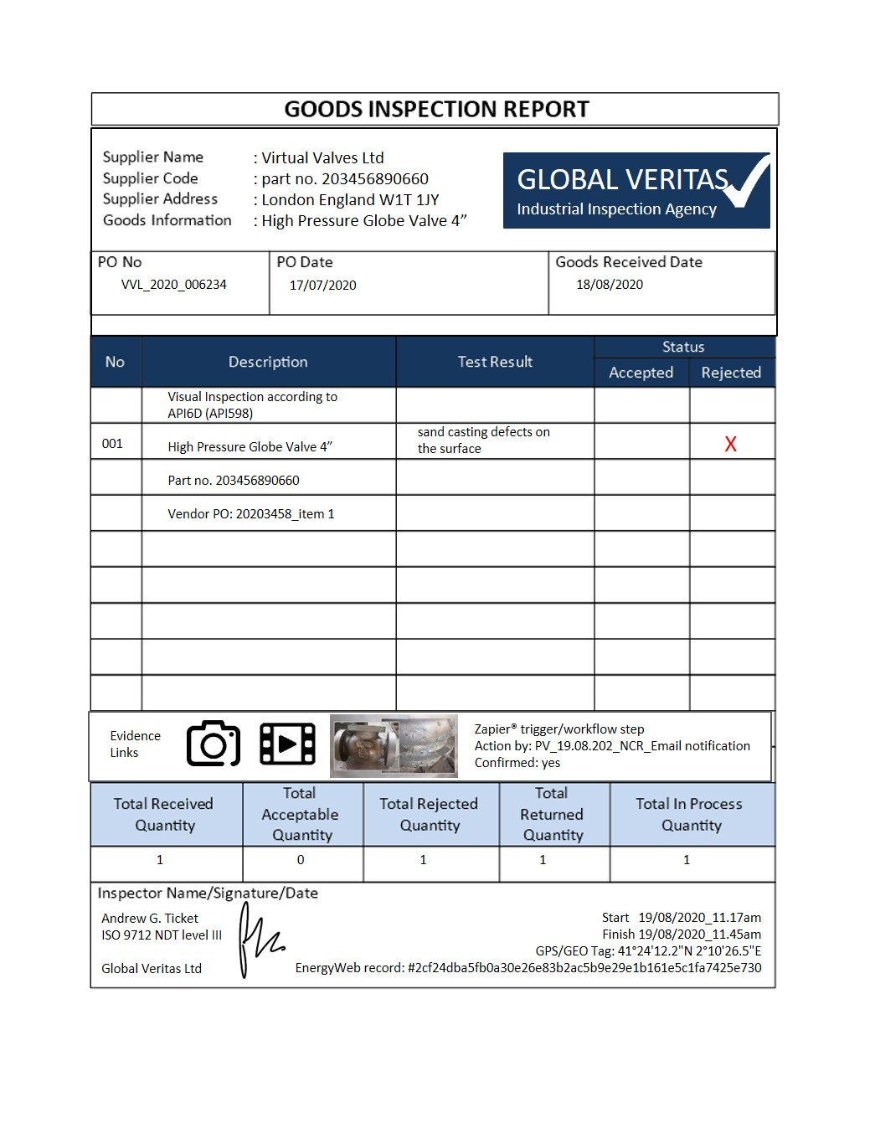
Use Case #5 – FAT’s & SIT’s
Increased service level & going paperless
Challenge
Project completion impact & delayed deliveries due to travel restrictions and border closures
Delayed and disrupted OEM equipment construction and delivery
Risk of other costs and expenses incurred due to late project completion
Entreprise aims to increase workers safety, productivity and operational efficiencies. Unlocking major cost savings and environmental impacts
Solution
Company representative or 3rd party travel not required
Customer views FAT equipment testing, approves and watches acceptance test via live video, allowing audience to comment and ask questions
Fully integrated test system environment
A step-by-step digital work process ensured that the FAT workforce is always compliant, efficient and inspection reports are generated automatically on-site.
REMOTE FACTORY ACCEPTANCE TEST

Slide 13

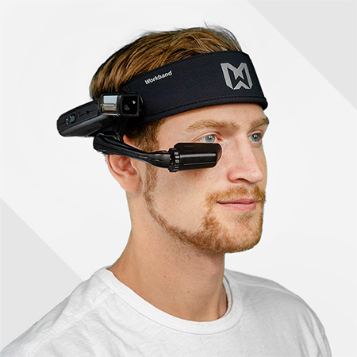
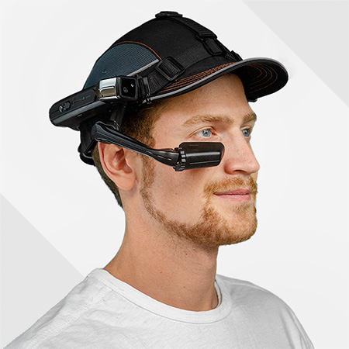
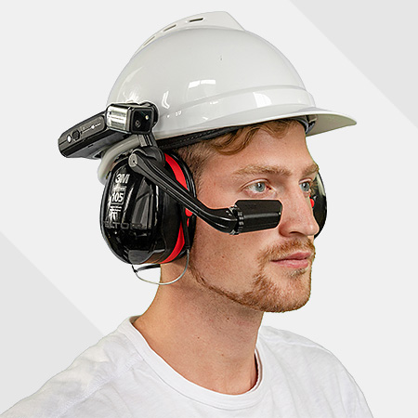


Start Work >>
Verification of inspector/user
Richard Baars
Global Veritas
ISO 9712 NDT level III
Specialties: NDT, Inspections, Valve Testing,
Leak Testing, Fugitive Emission Testing
Approval: Shell, Total, BP, ExxonMobil
Verification of (remote) device
Smart Phone, Tablet, Smart Glass, Head Mounted Tablet, Portable Camera
Eyes On Site
Scan Login Card

Slide 14


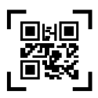





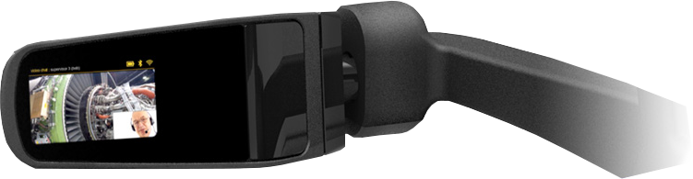

Home >>
My Tasks New Task Scan Task Call Support
Settings Workflows Preview Mod Exit Application
Active a job
  “Case: 725272730706”
Completed jobs
Frequently used workflows
Use multilingual voice commands
Speech-to-text dictation technology and free your hands from typing
Wireless data transfer via WIFI Bluetooth®

Slide 15
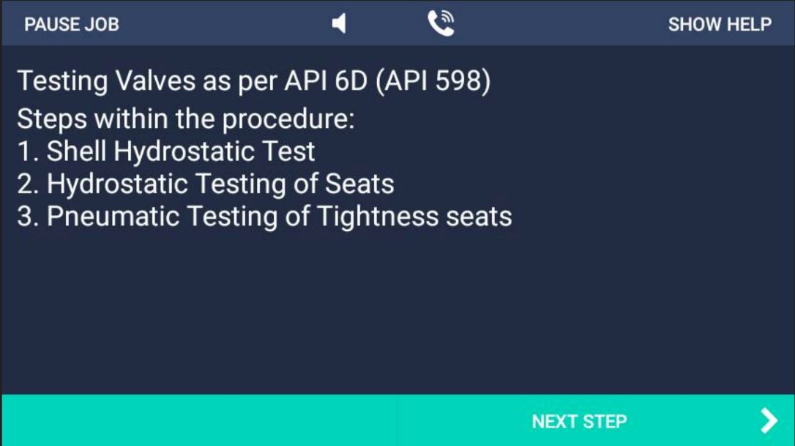
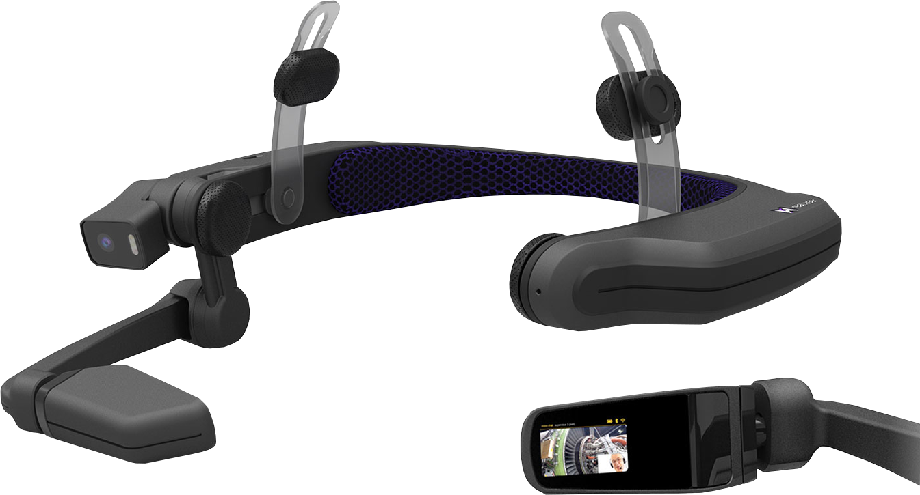
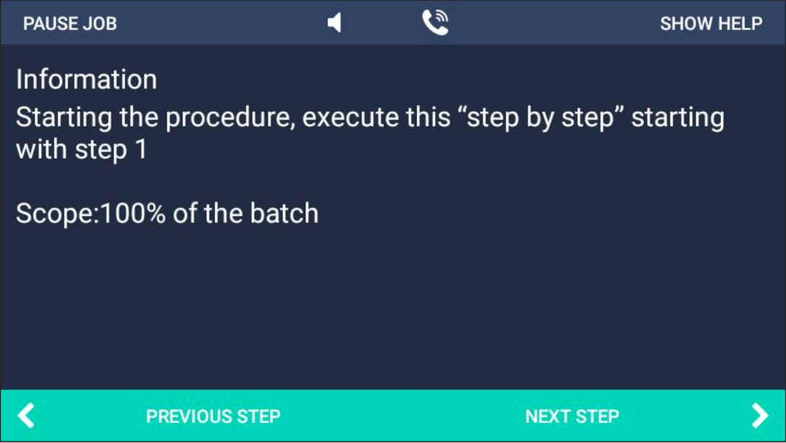
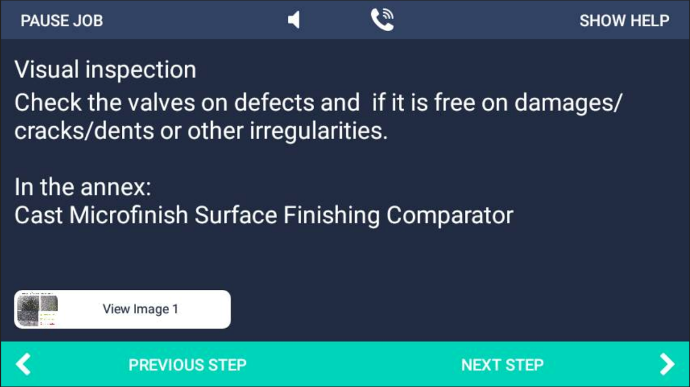
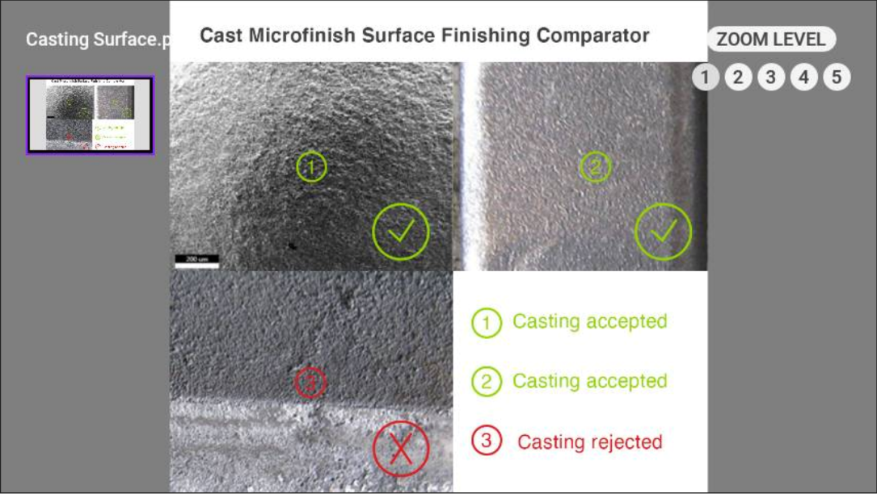


Slide 16
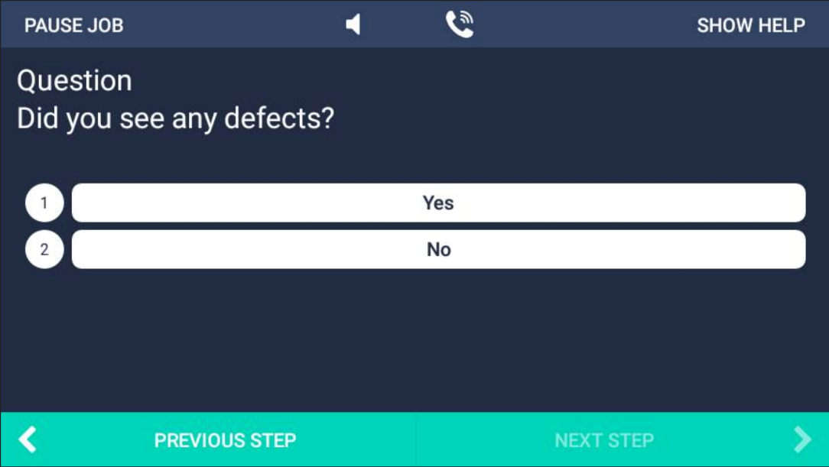
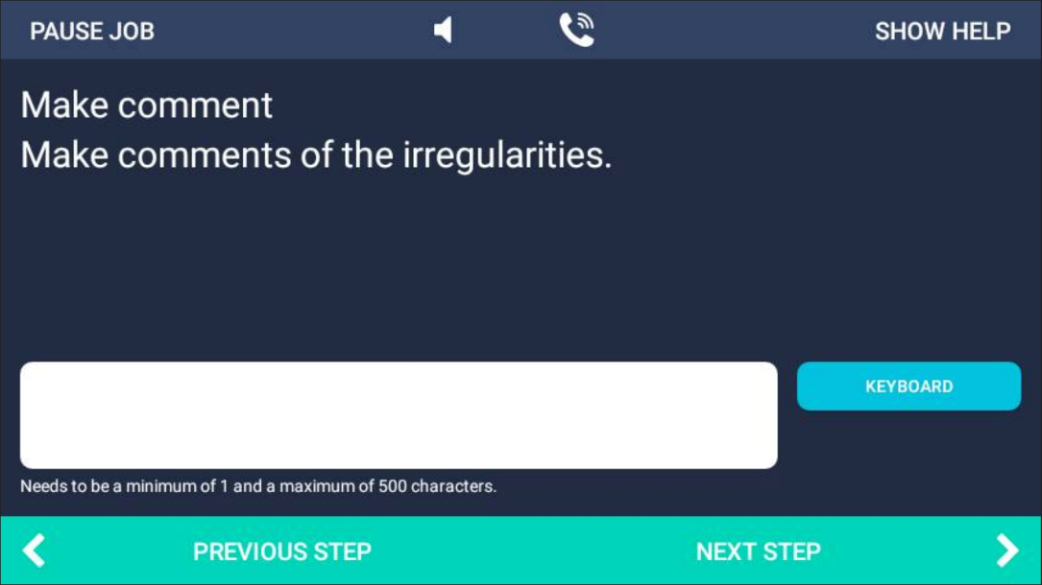
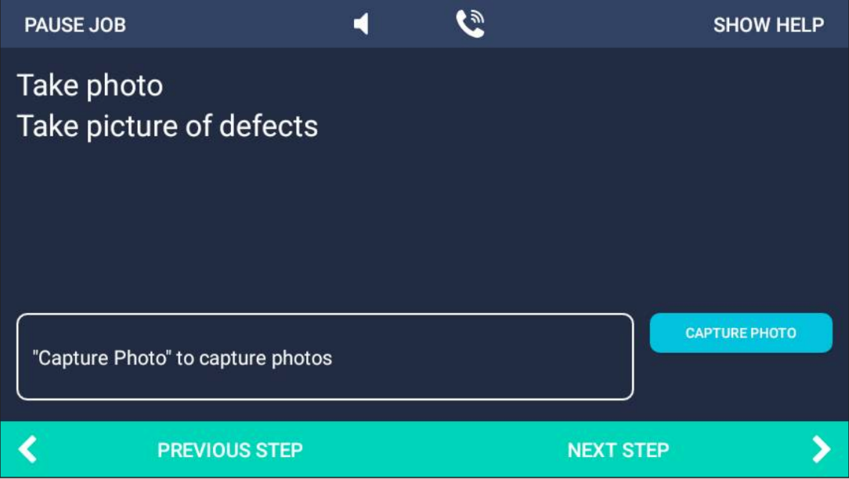
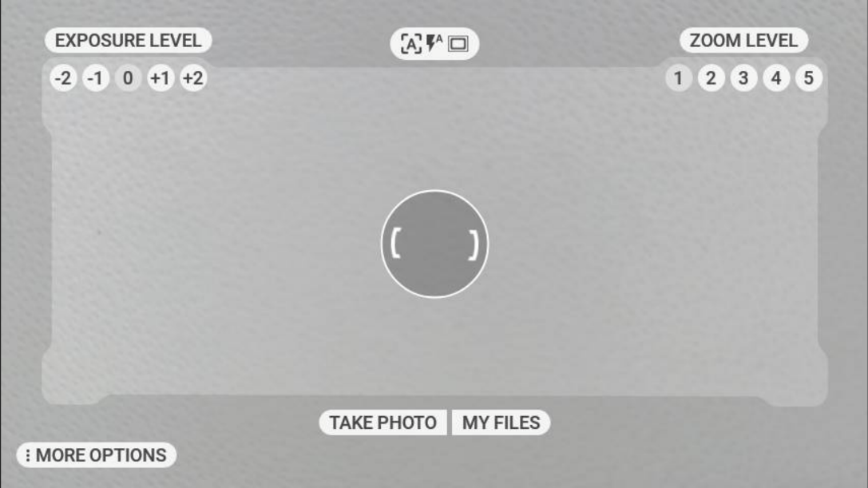
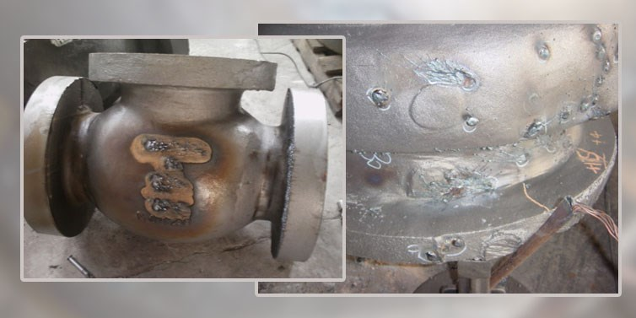

Slide 17
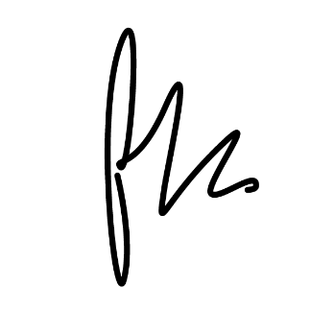


Sign off >>
Case: 725272730706
Verification Call Support
Signature Capture Preview Mode Exit Application
Executed by Richard Baars
Start 19/08/2020_11.17am
Finish 19/08/2020_11.45am
GPS/GEO tagging

Slide 18
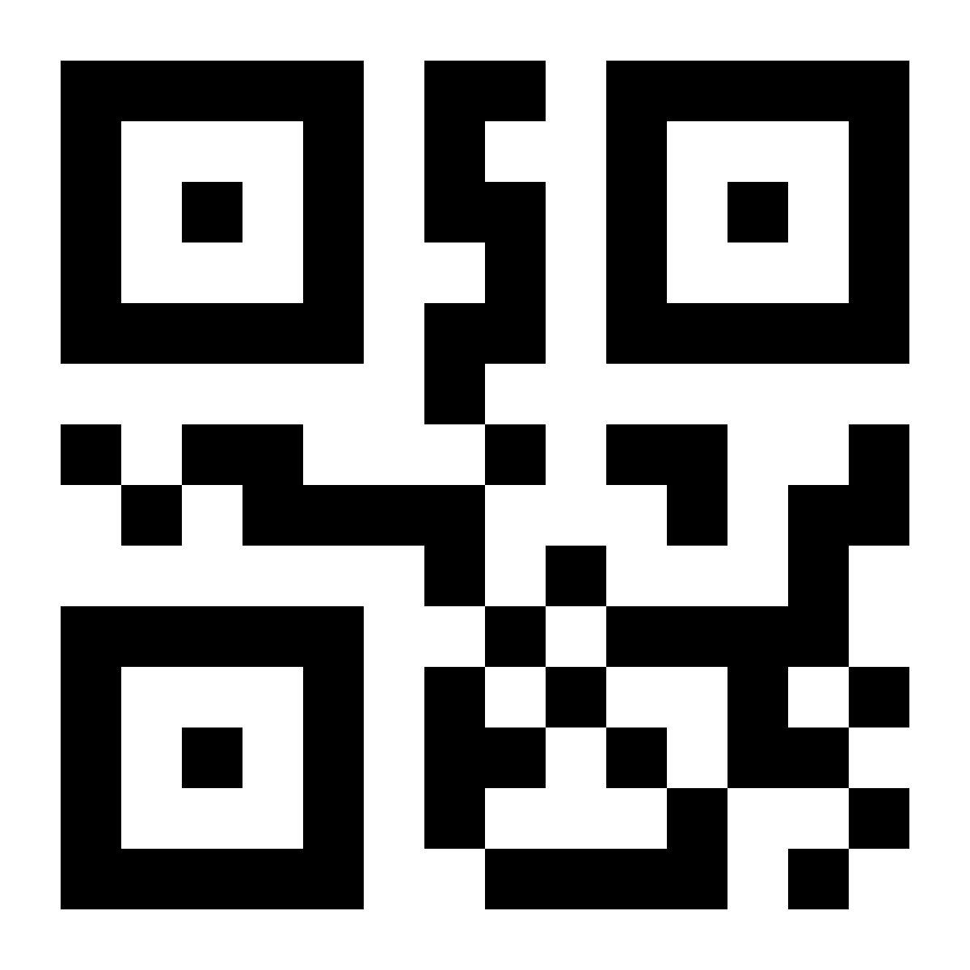
Sign off >>
Compliance with end user requirements
Reports are generated & distributed instantly
Evidence gathering:
comments, photo’s, videolinks
Standard or customized templates
Safe & secure data storage, on premises or cloud hosting
Set actions & triggers
Signature capture
Energyweb immutable data storage
Richard Baars
ISO 9712 NDT Level III
+31 (0)6 51 277521
Global Veritas Ltd
  Case 725272730706
Date, time & GEO tagging

Slide 19
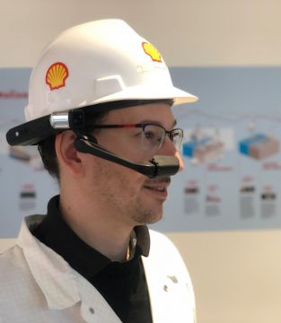
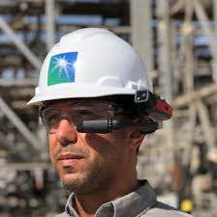
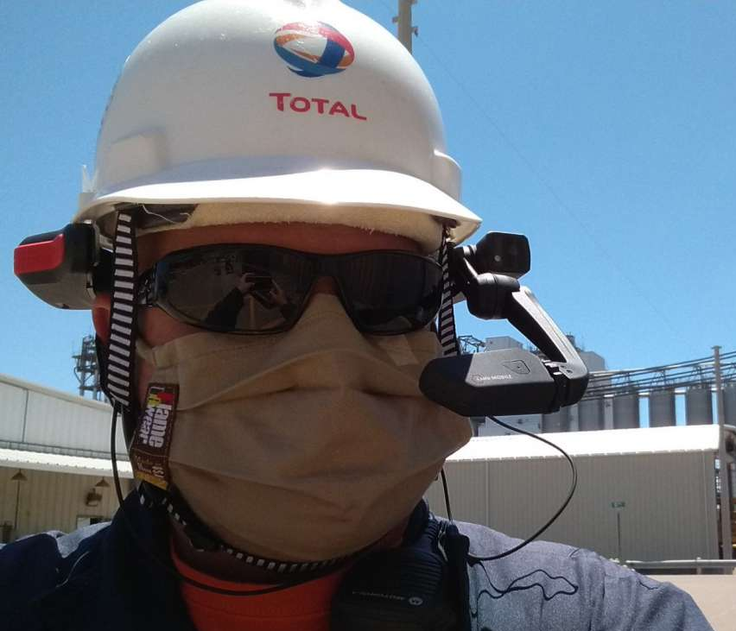
Boarding Calls
90% Decrease inspection- & reporting time
70% Increase safety compliance
30% Increase maintenance efficiency
Shell: “A new era of computing has arrived”
Saudi Aramco: “recorded a 70% increase in safety compliance on top of a 10% improvement in workforce productivity”
Total: “Connecting our field operators to Total’s experts and vendors, down the street or on the other side of the world, is particularly topical at a time when traveling is restricted”
Eastman: “100% Reliable Restoration in Confined Space”
NOV: “SMEs offshore travel not required”
Nestlé: “The remote support approach isn’t just a response to COVID-19 though. Going forward, remote assistance will become a new way of working”

Slide 20
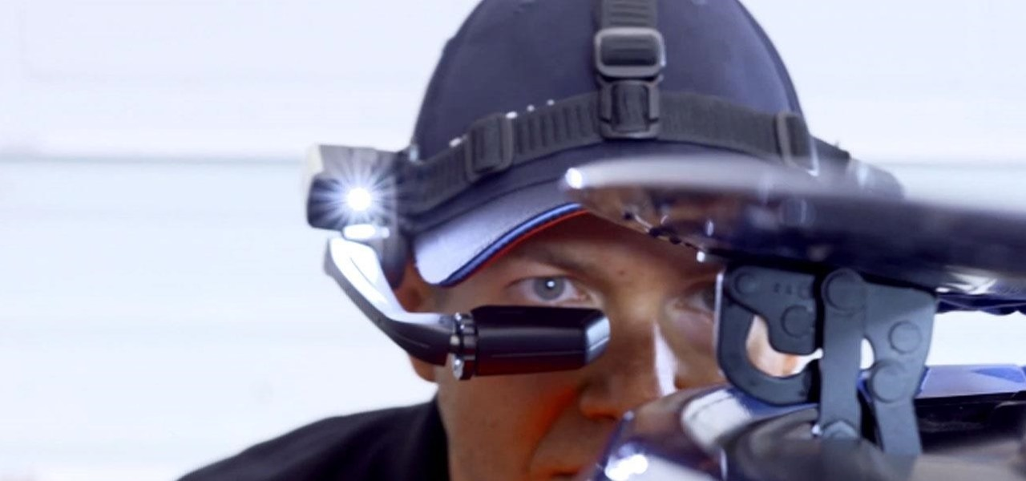


Let’s work remotely
Together!
info@vmatch.nl
www.vmatch.nl
Vmatch’s commitment to facilitating in-situation Knowledge Transfer, at the network’s edge, delivering ruggedized Industrial IIoT solutions designed to improve field/factory worker safety, productivity and accuracy.

Slide 21

Q & A SESSION
ORGANIZERS
SCIENTIFIC COMMITTEE
Thank you for your attention!
IVS 2022
Technical Conference

