Slide 1
VALERIA TIRELLI
ORGANIZERS
SCIENTIFIC COMMITTEE
President & CEO at AIDRO – a Desktop Metal company
Additive Manufacturing
and Digital Inventory:
dreams or reality for the Energy sector?
IVS 2022
Technical Conference

Slide 2
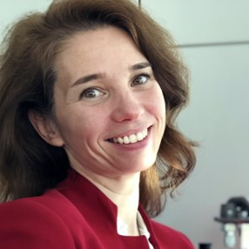
Biography
President & CEO at Aidro – a Desktop Metal companny
Expert in hydraulics
Passionate about Additive Manufacturing
ASTM ICAM Scientific Organizing Committee for AM in Energy, Maritime and Oil & Gas
AM Energy Steering Committee Member
IVS Advisory Board Member
API 20S TG Member – Additive Manufacturing
AIPnD Non Destructive Test Additive Manufacturing Committee
Ambassador of Women in 3D Printing

Slide 3
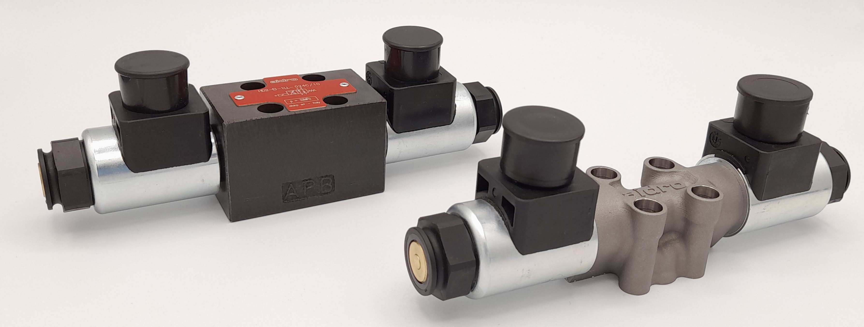
Additive Manufacturing
-60% weight
Conventional casting vs additive manufacturing

Slide 4
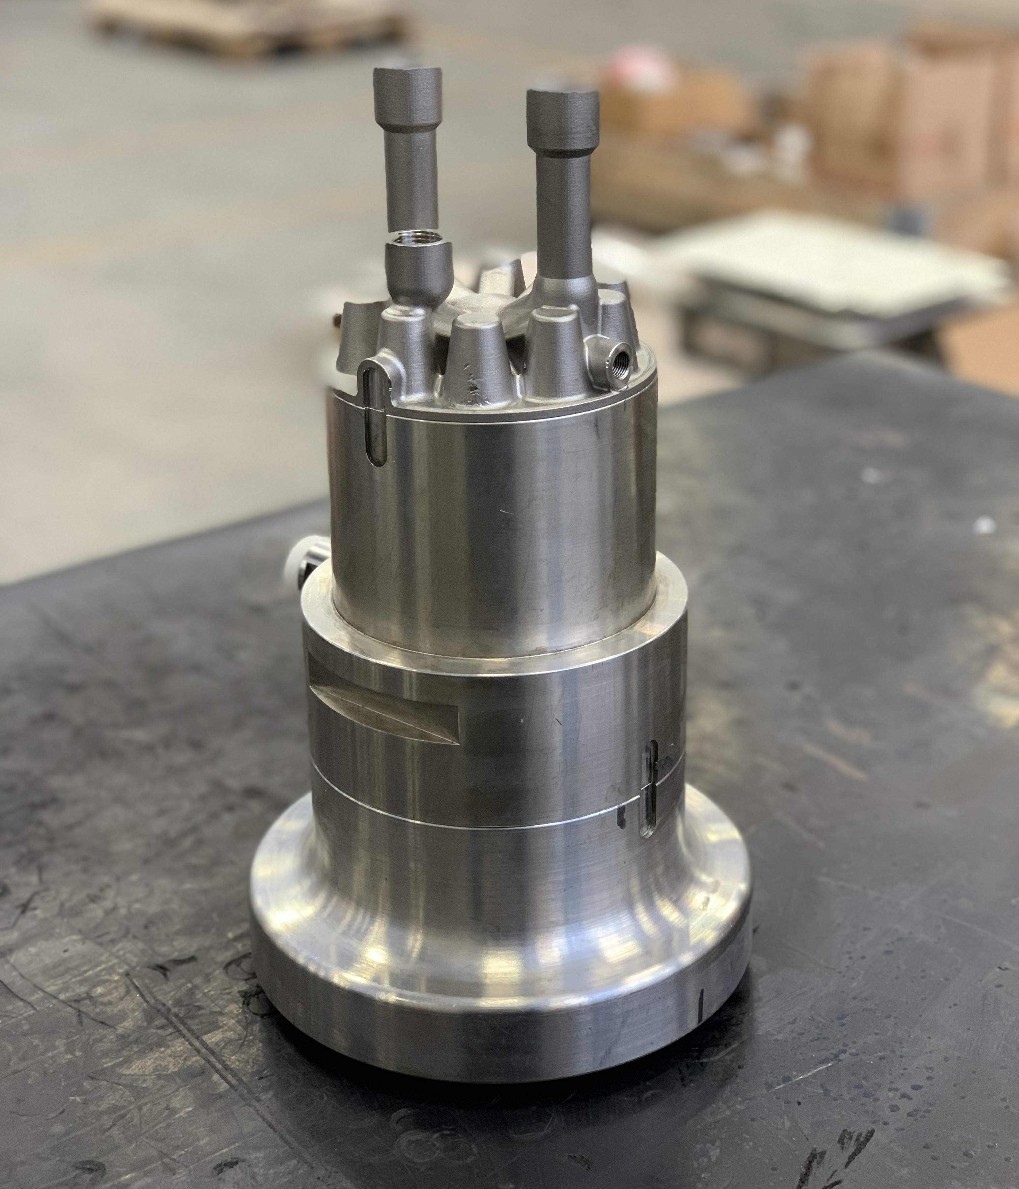
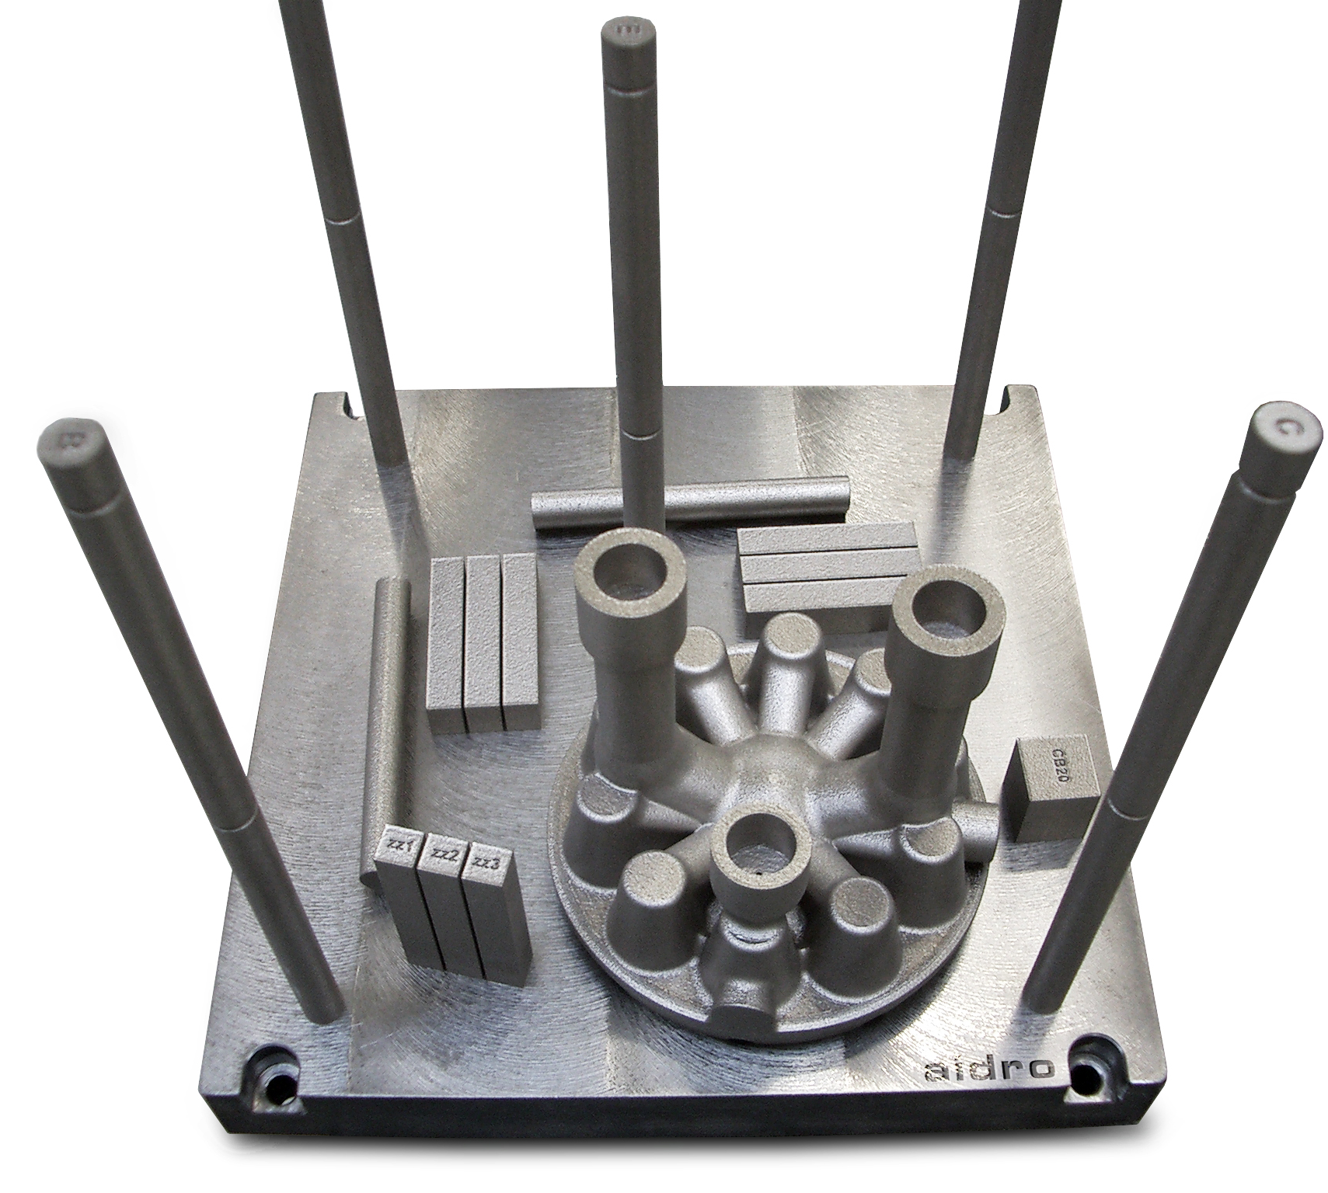
Additive Manufacturing

Slide 5
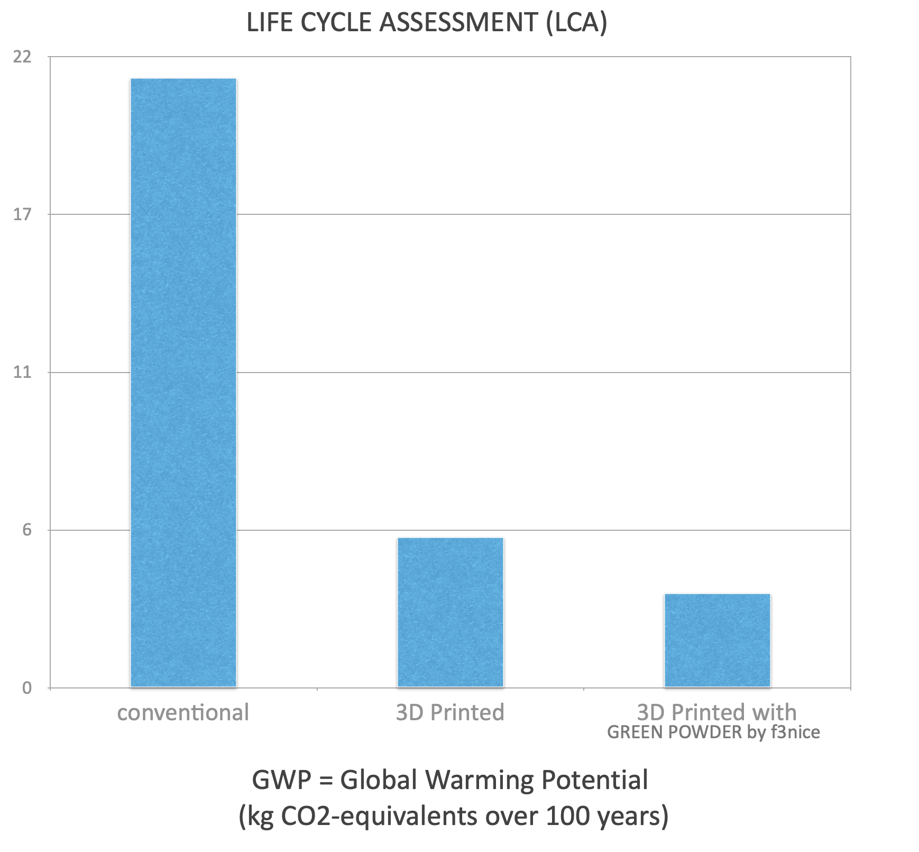
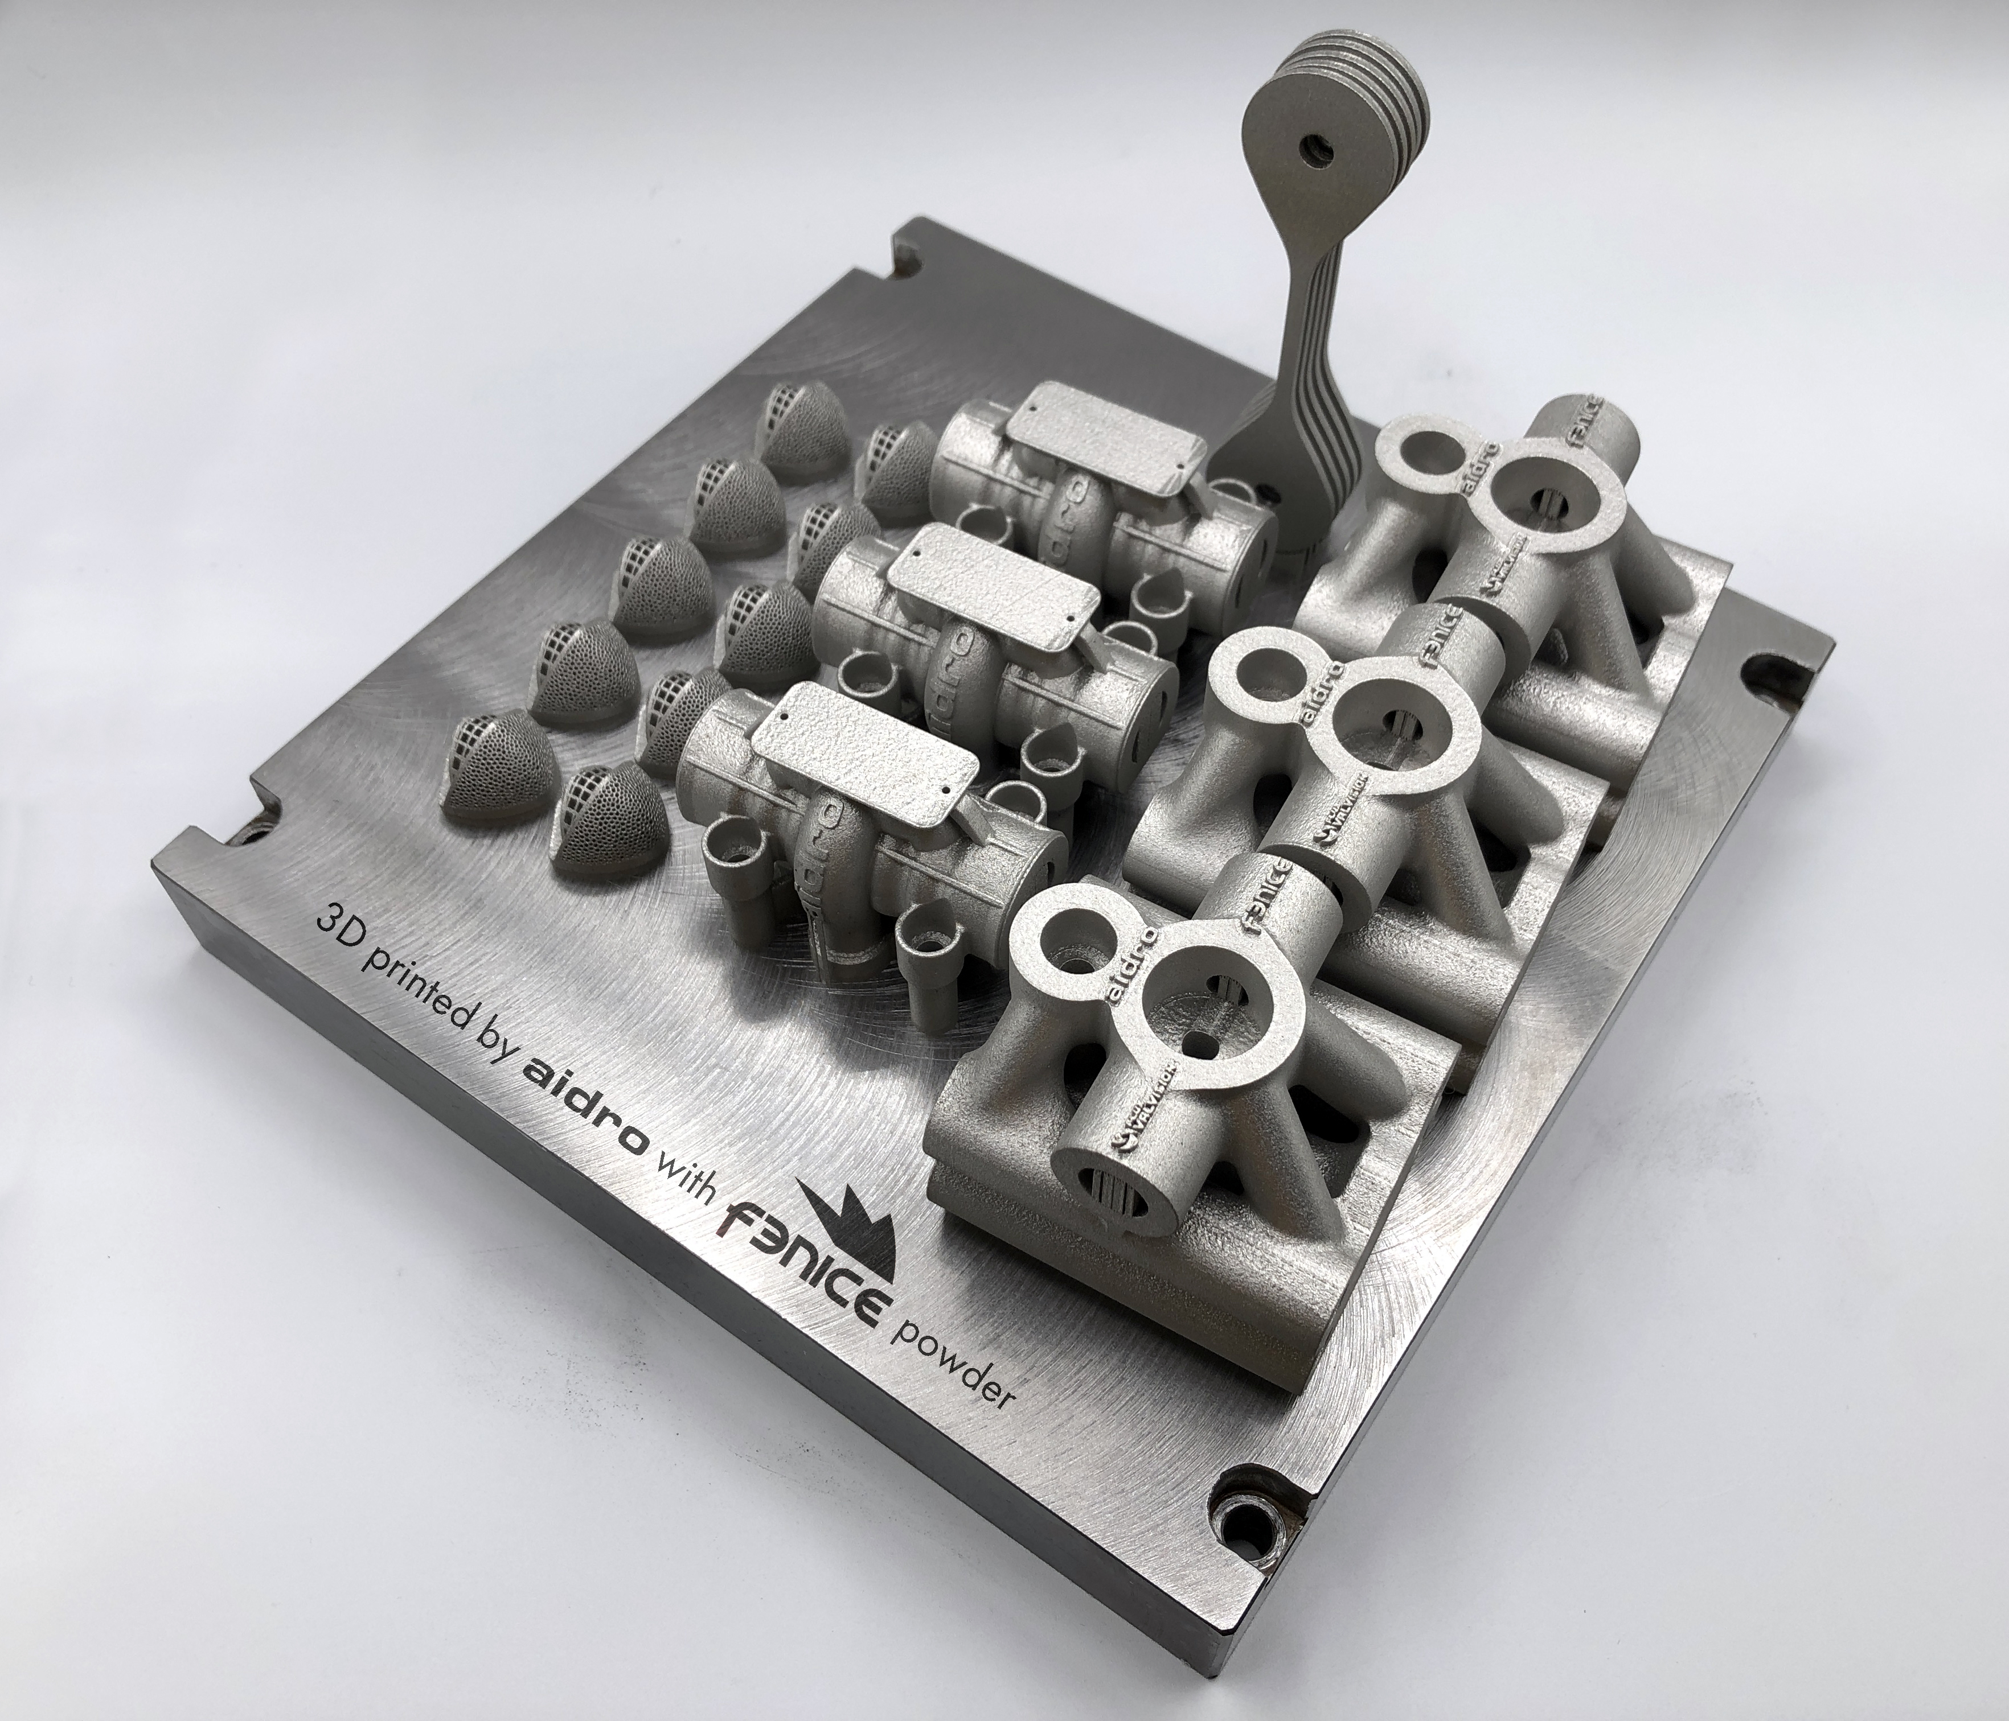
Sustainability

Slide 7
BREDE LAERUM
ORGANIZERS
SCIENTIFIC COMMITTEE
Head of Additive Manufacturing Centre of Excellence, Equinor
How Digital Inventories and AM will transform the supply chain
IVS 2022
Technical Conference

Slide 8
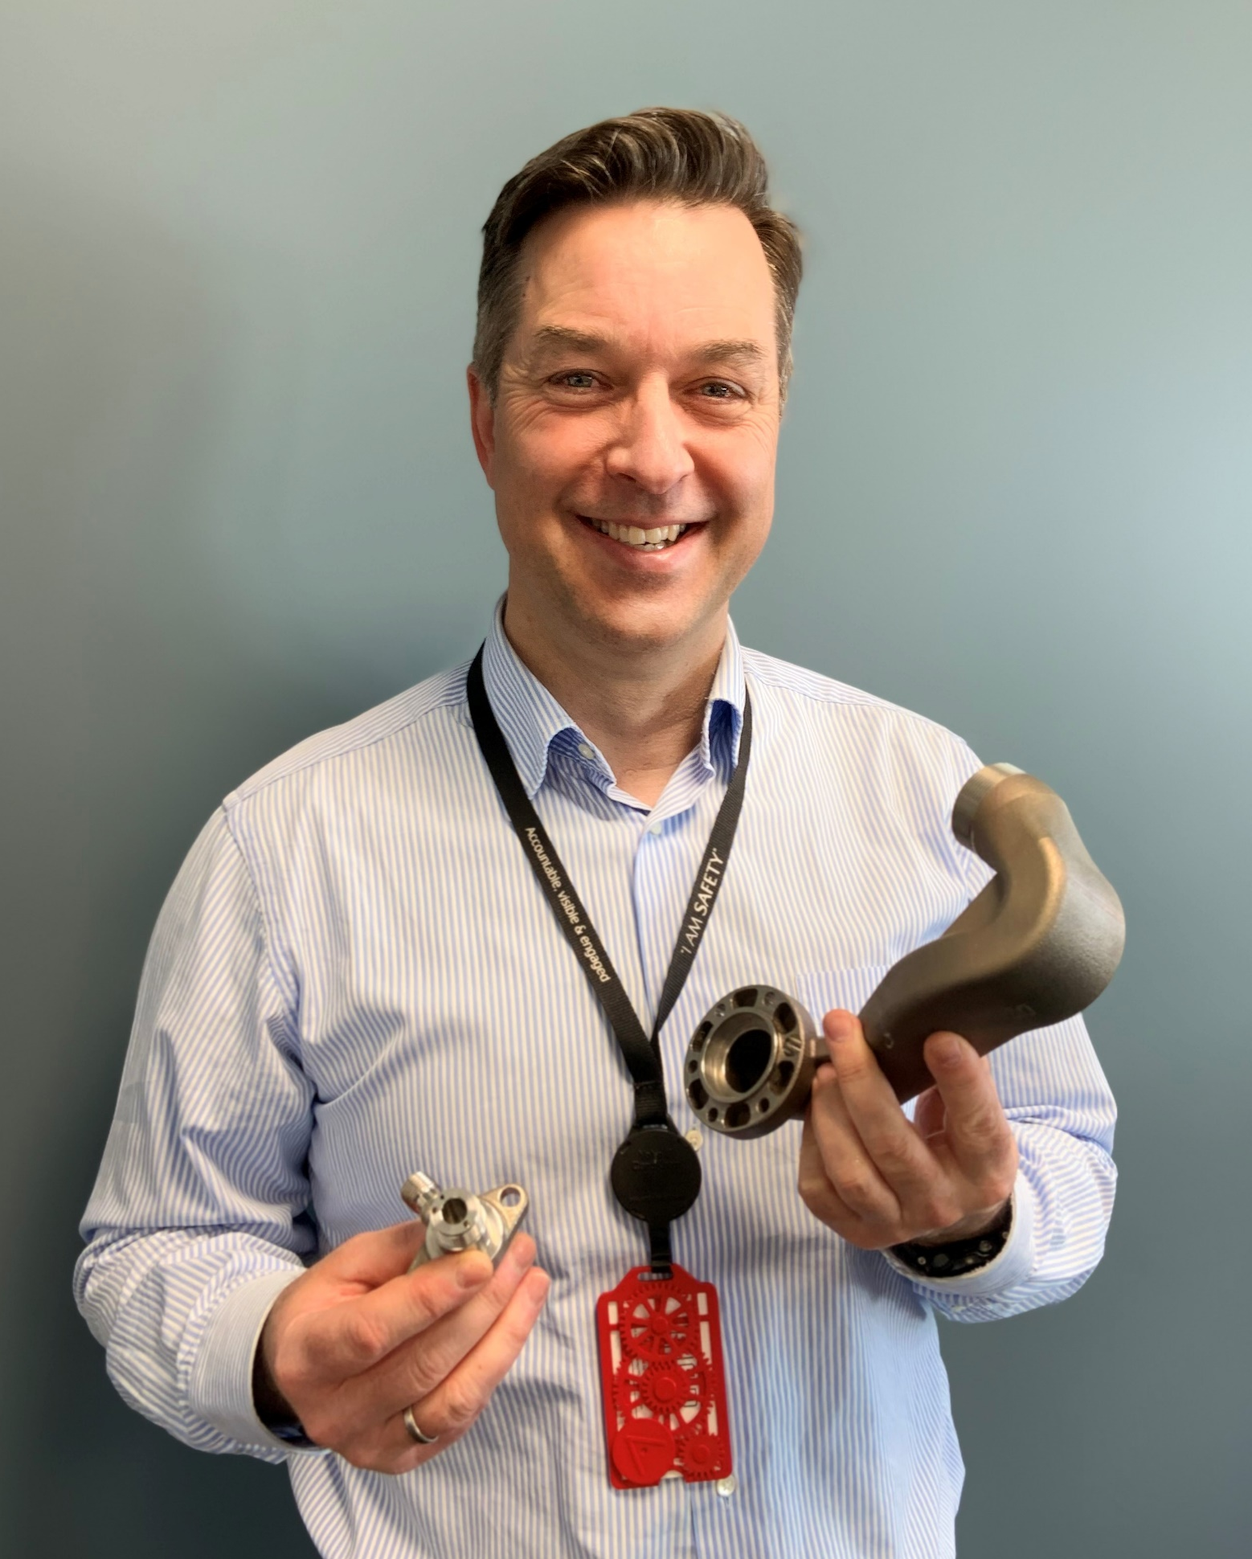
Biography
I have been in Equinor, the largest energy company in Norway, for 24 years, in various engineering and management positions within operations, maintenance, modifications and digitalisation. I am now Head of the Additive Manufacturing Centre of Excellence in Equinor. I have been the chairman of the Joint Industry Project Digital Inventory, where Fieldmade, Equinor, Totalenergies and Siemens Energy collaborated to develop a Digital Inventory ecosystem software solution, and chairman of the international network “AM Energy”. My ambition is that the use of Additive Manufacturing and Digital Inventories is accelerated globally in order to reduce cost, reduce physical inventories, reduce lead time, reduce environmental footprint, increase local value creation and increase supply
resilience.

Slide 9
Equinor - A leading company in the energy transition
Turning natural resources into energy for people, and progress for society

Slide 10
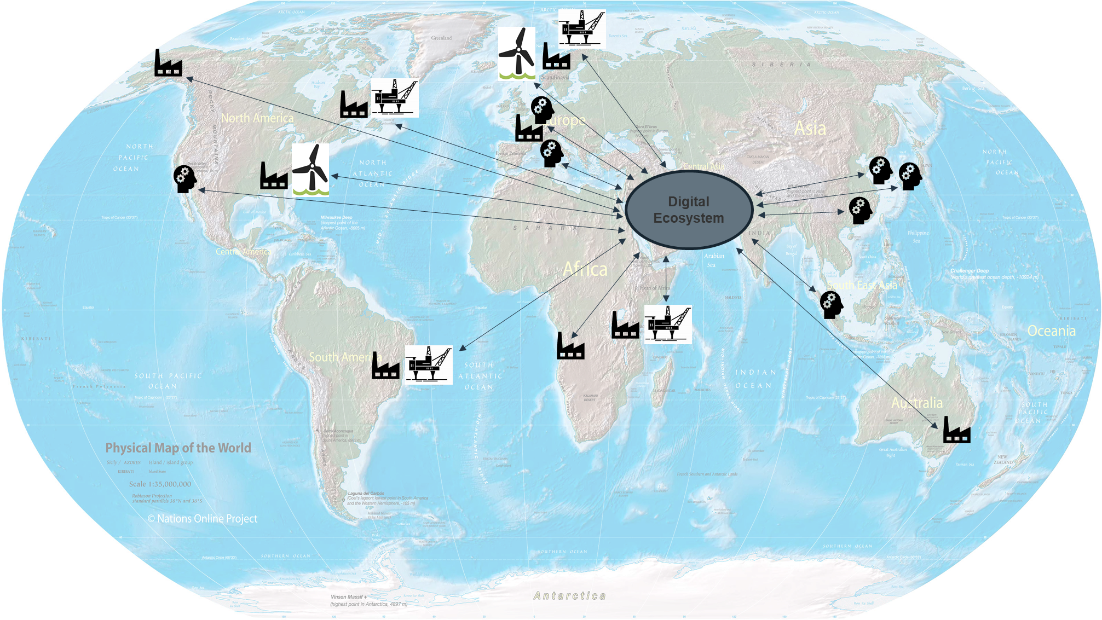
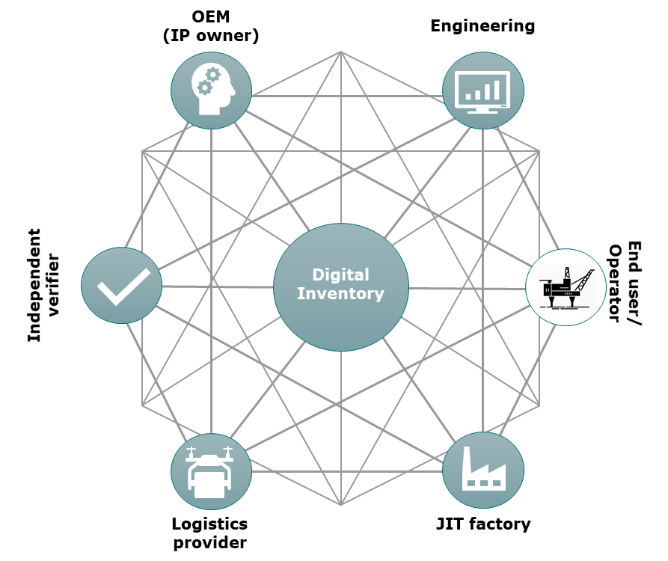
Digital Inventory collaboration
04.2020 – 04.2022
Launch of “Fieldnode”
1.may 2022
Global Digital Supply Network
Digital Inventory JIP
- Develop platform
Digital Inventories and
local, on-demand
manufacturing of parts
Target (5yrs):
100k digital parts
200 OEMs
200 Factories
10 DfAM providers

Slide 11
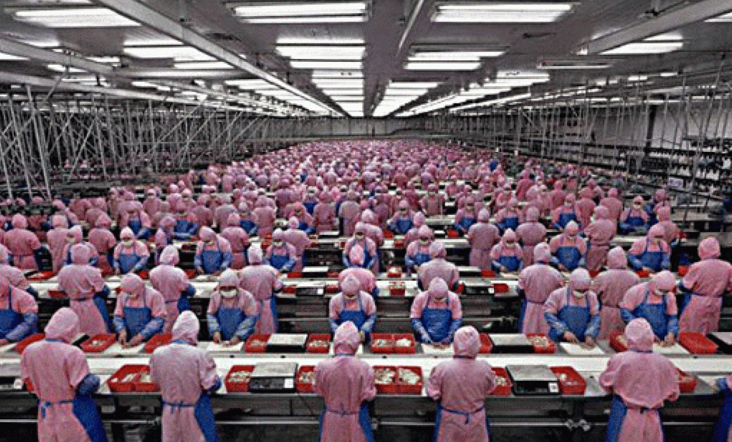
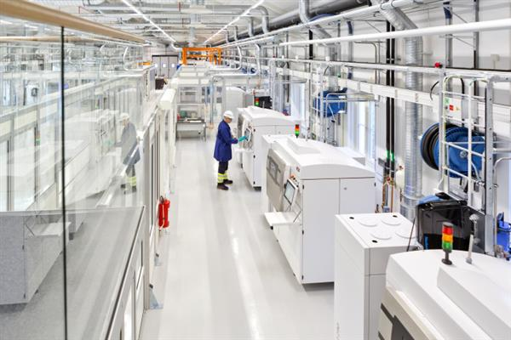
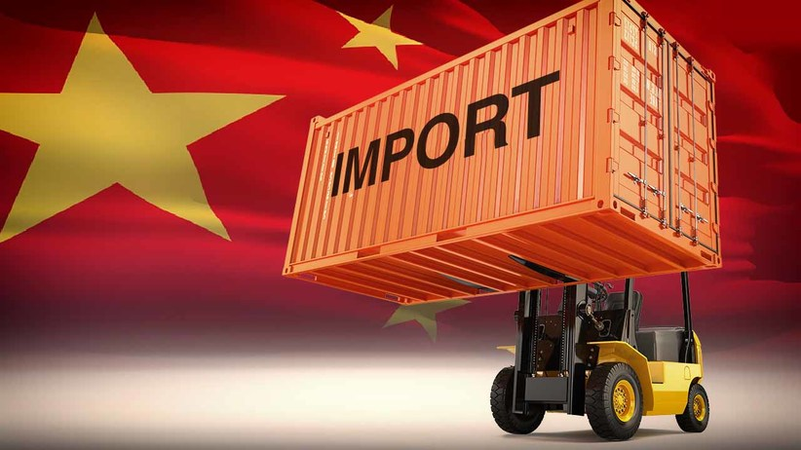
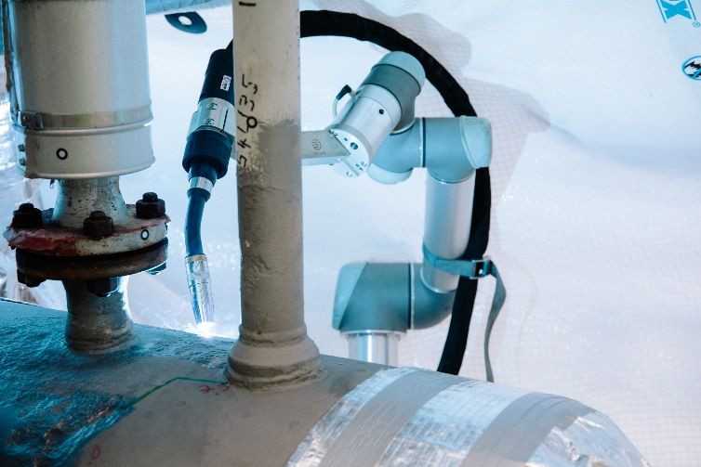
«Homesourcing»
Low competence/High staffing
High competence /Low staffing
Source: IndustryWeek
Source: Siemens
Transport, Import and storage
Local services and manufacturing
Source: Hubco
Source: Equinor
Remove waste and Improve supply resilience

Slide 12
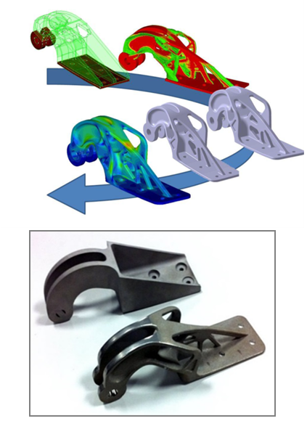
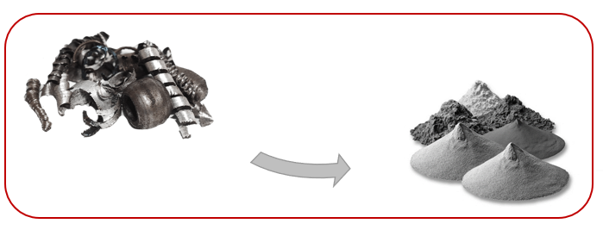
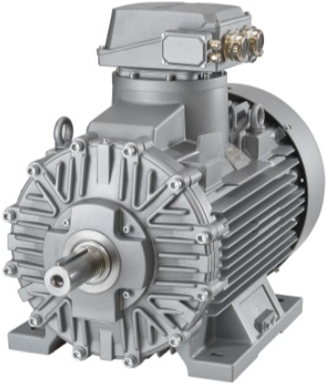
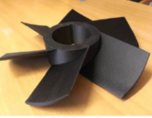
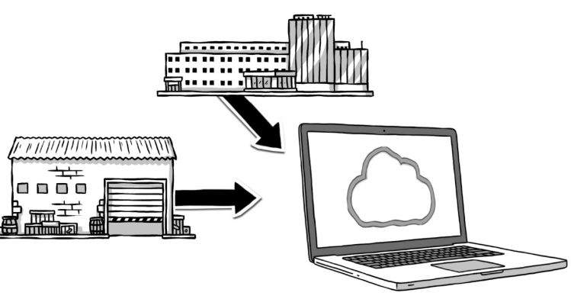
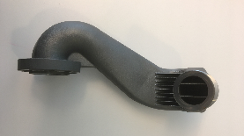
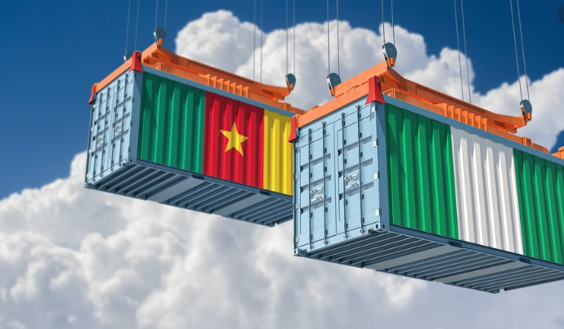
Sustainability
Recycling
Raw material
Manufacturing
Decommissioning
Operations and maintenance
Design
Reduced waste
Extended lifetime
Digital Inventory
Improved function
Reduced Transport

Slide 13
Additive Mindset
AM as an enabler for new ways of working
Minimum Viable Product (MVP) vs. full replacement
No obsolesence
AM repair
Optimisation of design and functionality
On-demand production
Flexible manufacturing with short lead time
Digital Supply Network (DSN) vs. Linear supply chain
Sustainability and circular economy
Supply resilience
Source: Getty Images

Slide 15
ANGELINE GOH
ORGANIZERS
SCIENTIFIC COMMITTEE
Additive Manufacturing Technology Manager,
Shell Global Solution International BV Company
Additive Manufacturing in Shell
IVS 2022
Technical Conference

Slide 16
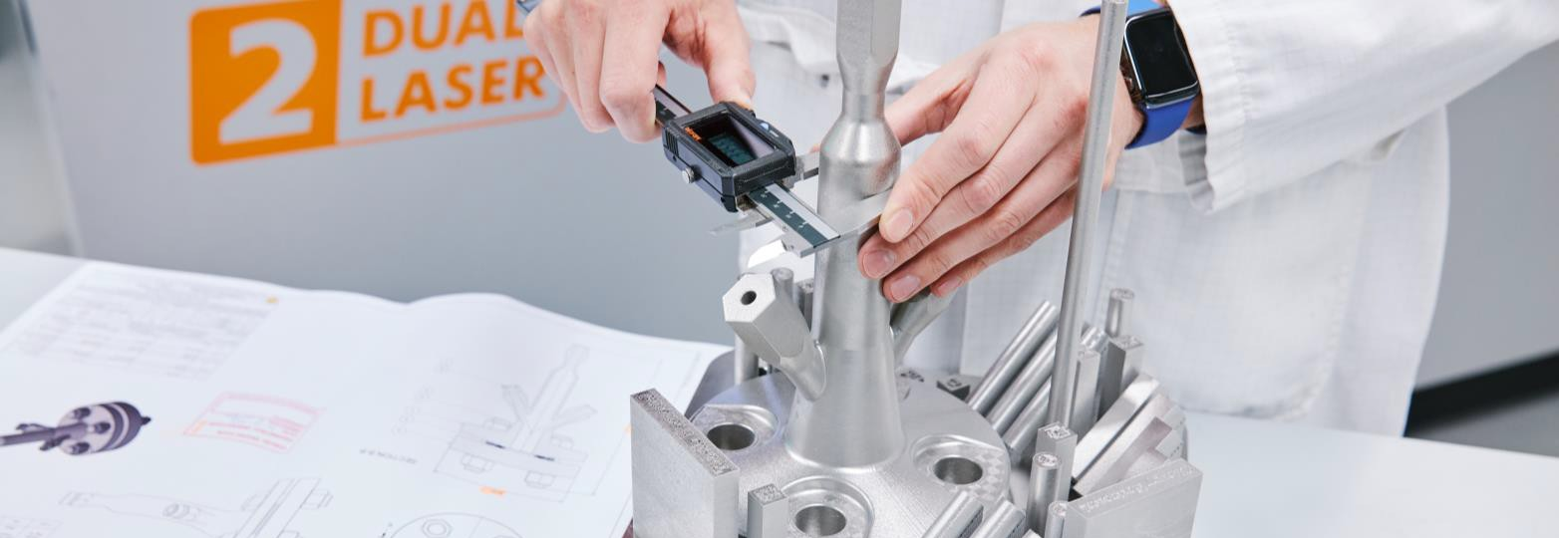
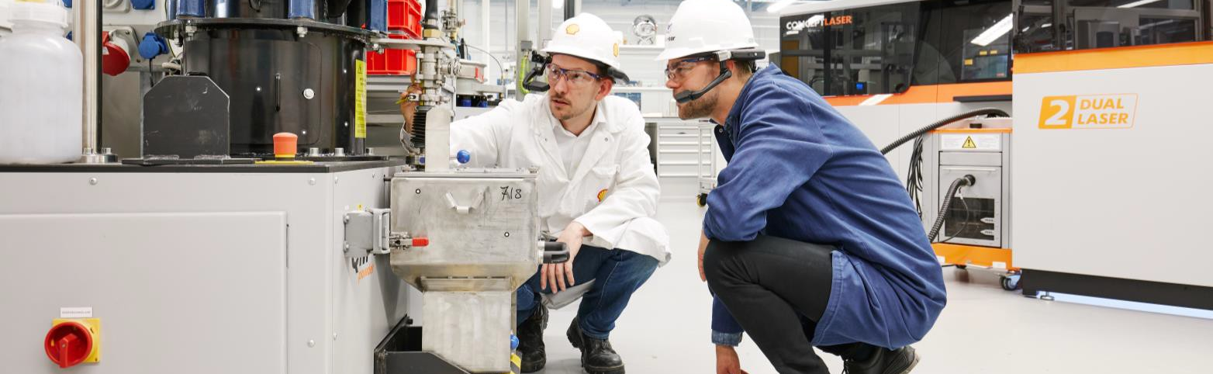
Biography
@Angeline Goh

Slide 17
Definitions & cautionary note
The companies in which Shell plc directly and indirectly owns investments are separate legal entities. In this presentation “Shell”, “Shell Group” and “Group” are sometimes used for convenience where references are made to Shell plc and its subsidiaries in general. Likewise, the words “we”, “us” and “our” are also used to refer to Shell plc and its subsidiaries in general or to those who work for them. These terms are also used where no useful purpose is served by identifying the particular entity or entities. ‘‘Subsidiaries’’, “Shell subsidiaries” and “Shell companies” as used in this presentation refer to entities over which Shell plc either directly or indirectly has control. Entities and unincorporated arrangements over which Shell has joint control are generally referred to as “joint ventures” and “joint operations”, respectively. Entities over which Shell has significant influence but neither control nor joint control are referred to as “associates”. The term “Shell interest” is used for convenience to indicate the direct and/or indirect ownership interest held by Shell in an entity or unincorporated joint arrangement, after exclusion of all third-party interest.
This presentation contains forward-looking statements (within the meaning of the U.S. Private Securities Litigation Reform Act of 1995) concerning the financial condition, results of operations and businesses of Shell. All statements other than statements of historical fact are, or may be deemed to be, forward-looking statements. Forward-looking statements are statements of future expectations that are based on management’s current expectations and assumptions and involve known and unknown risks and uncertainties that could cause actual results, performance or events to differ materially from those expressed or implied in these statements. Forward-looking statements include, among other things, statements concerning the potential exposure of Shell to market risks and statements expressing management’s expectations, beliefs, estimates, forecasts, projections and assumptions. These forward-looking statements are identified by their use of terms and phrases such as “aim”, “ambition”, ‘‘anticipate’’, ‘‘believe’’, ‘‘could’’, ‘‘estimate’’, ‘‘expect’’, ‘‘goals’’, ‘‘intend’’, ‘‘may’’, “milestones”, ‘‘objectives’’, ‘‘outlook’’, ‘‘plan’’, ‘‘probably’’, ‘‘project’’, ‘‘risks’’, “schedule”, ‘‘seek’’, ‘‘should’’, ‘‘target’’, ‘‘will’’ and similar terms and phrases. There are a number of factors that could affect the future operations of Shell and could cause those results to differ materially from those expressed in the forward-looking statements included in this presentation, including (without limitation): (a) price fluctuations in crude oil and natural gas; (b) changes in demand for Shell’s products; (c) currency fluctuations; (d) drilling and production results; (e) reserves estimates; (f) loss of market share and industry competition; (g) environmental and physical risks; (h) risks associated with the identification of suitable potential acquisition properties and targets, and successful negotiation and completion of such transactions; (i) the risk of doing business in developing countries and countries subject to international sanctions; (j) legislative, judicial, fiscal and regulatory developments including regulatory measures addressing climate change; (k) economic and financial market conditions in various countries and regions; (l) political risks, including the risks of expropriation and renegotiation of the terms of contracts with governmental entities, delays or advancements in the approval of projects and delays in the reimbursement for shared costs; (m) risks associated with the impact of pandemics, such as the COVID-19 (coronavirus) outbreak; and
(n) changes in trading conditions. No assurance is provided that future dividend payments will match or exceed previous dividend payments. All forward-looking statements contained in this presentation are expressly qualified in their entirety by the cautionary statements contained or referred to in this section. Readers should not place undue reliance on forward-looking statements. Additional risk factors that may affect future results are contained in Shell plc’s Form 20-F for the year ended December 31, 2020 (available at www.shell.com/investor and www.sec.gov). These risk factors also expressly qualify all forward-looking statements contained in this presentation and should be considered by the reader. Each forward-looking statement speaks only as of the date of this presentation, 25 May 2022. Neither Shell plc nor any of its subsidiaries undertake any obligation to publicly update or revise any forward- looking statement as a result of new information, future events or other information. In light of these risks, results could differ materially from those stated, implied or inferred from the forward-looking statements contained in this presentation. The content of websites referred to in this presentation does not form part of this presentation.
We may have used certain terms, such as resources, in this presentation that the United States Securities and Exchange Commission (SEC) strictly prohibits us from including in our filings with the SEC. Investors are urged to consider closely the disclosure in our Form 20-F, File No 1-32575, available on the SEC website www.sec.gov

Slide 18
A personal Story

Slide 19
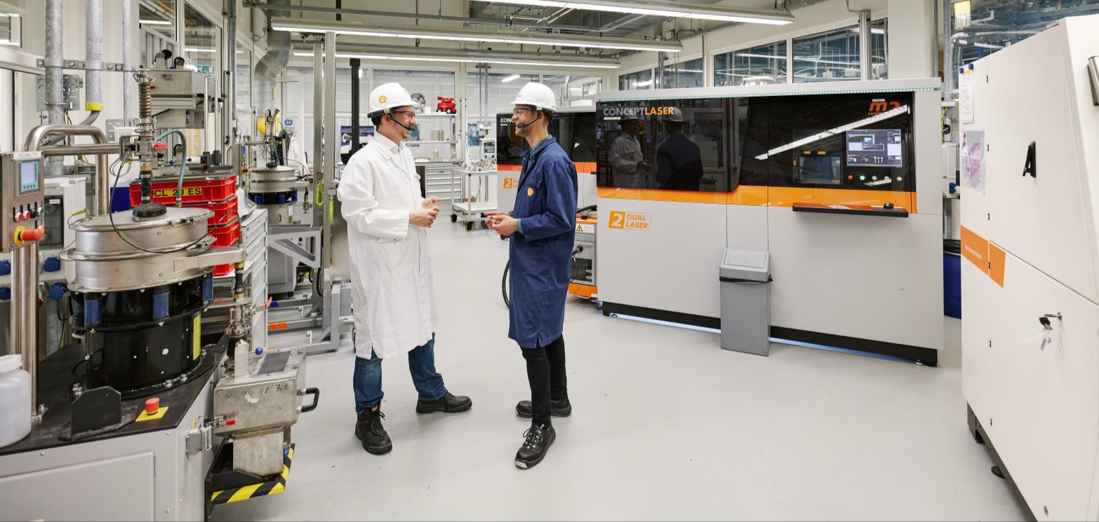
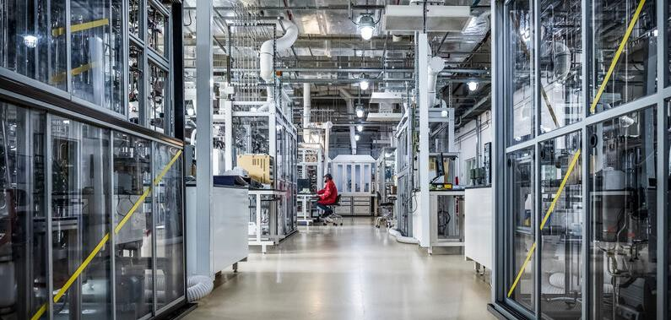
Additive Manufacturing in Shell
Spare parts
Novel design
Energy Transition Campus Amsterdam
Shell Technology Center Bangalore
Visualization &
rapid prototyping

Slide 20
Overcoming challenges of the traditional materials supply chain

Slide 21
Digital warehouses in the cloud

Slide 22
Additive Manufacturing in end-to-end digital technology workflows
End-to-end digital technology integration

Slide 23
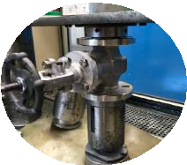
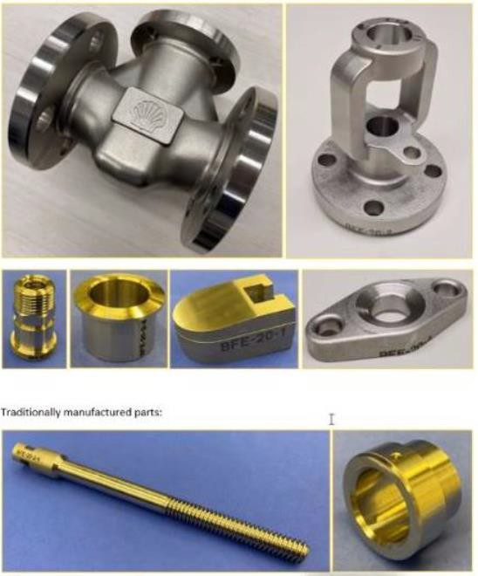
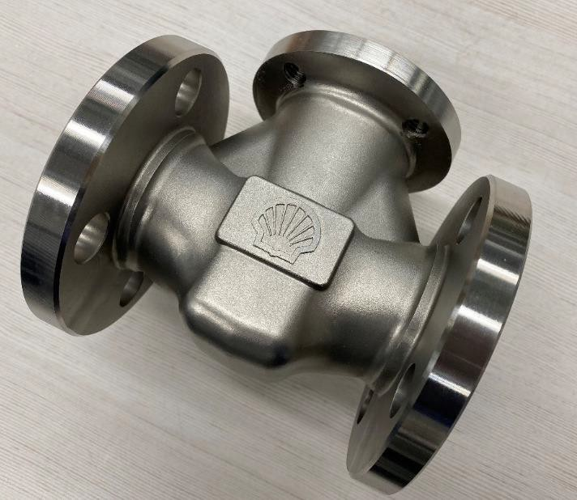
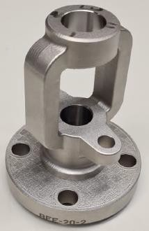
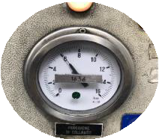
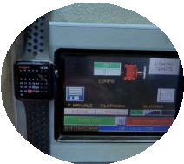
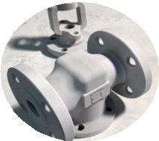
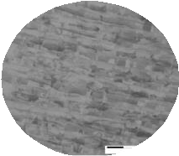
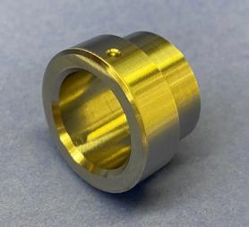
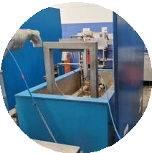
Challenge: Qualification of 1 Inch Class 150 F316-L 3D Printed Valve

Slide 24
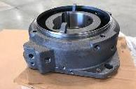
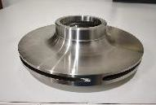
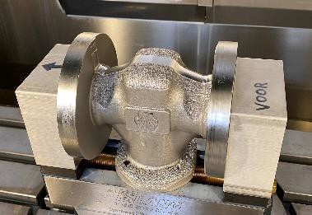
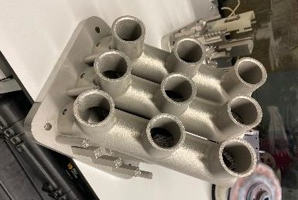
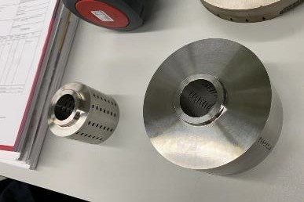
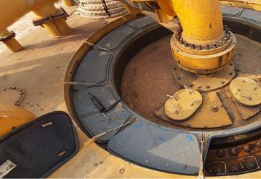
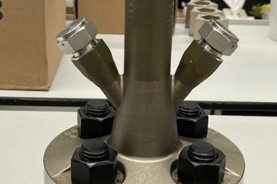
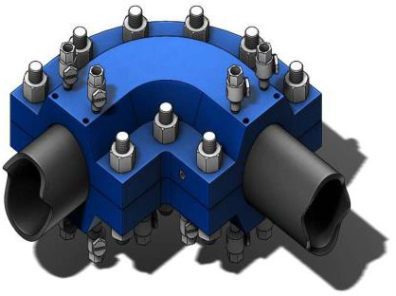
Selection of 3D printed parts in Shell

Slide 25
Now is the time to Think Bigger and work together

Slide 27
Edwige Ravry
ORGANIZERS
SCIENTIFIC COMMITTEE
Additive Manufacturing & Digital Inventory Product Owner
Additive Manufacturing in TotalEnergies
IVS 2022
Technical Conference

Slide 28
Biography
After graduating from HEC Paris with an MBA Edwige joined Total as an Economist, working first in Paris then Aberdeen, Scotland. From the very start she found herself drawn to technical topics and during her following assignment in Canada she transitioned from Joint Venture representative to Development Studies Lead. She then went back to school to become a Drilling Engineer and worked on Drilling Rigs in Argentina then Scotland. Following an equipment failure, in January 2017, that caused significant delay to operations she googled Additive Manufacturing and had an epiphany : one day Oil & Gas operators will store spare parts as virtual files in a “Digital warehouse” and print them on demand, close to site. She embarked on a quest to make this vision come true and has been at it ever since. Edwige is currently Additive Manufacturing & Digital Inventory Product Owner, working in Total’s OneTech division and based in Paris.

Slide 29
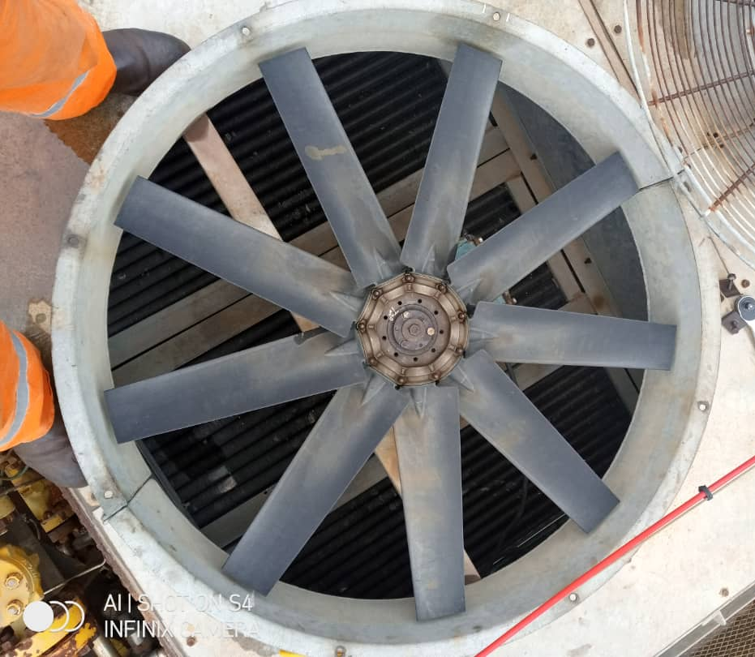
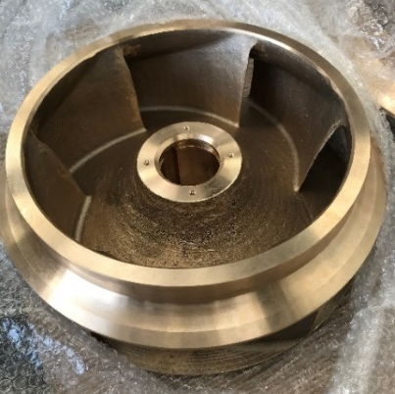
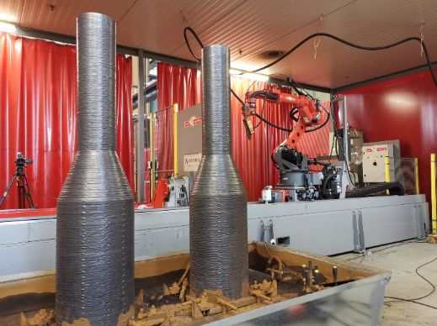
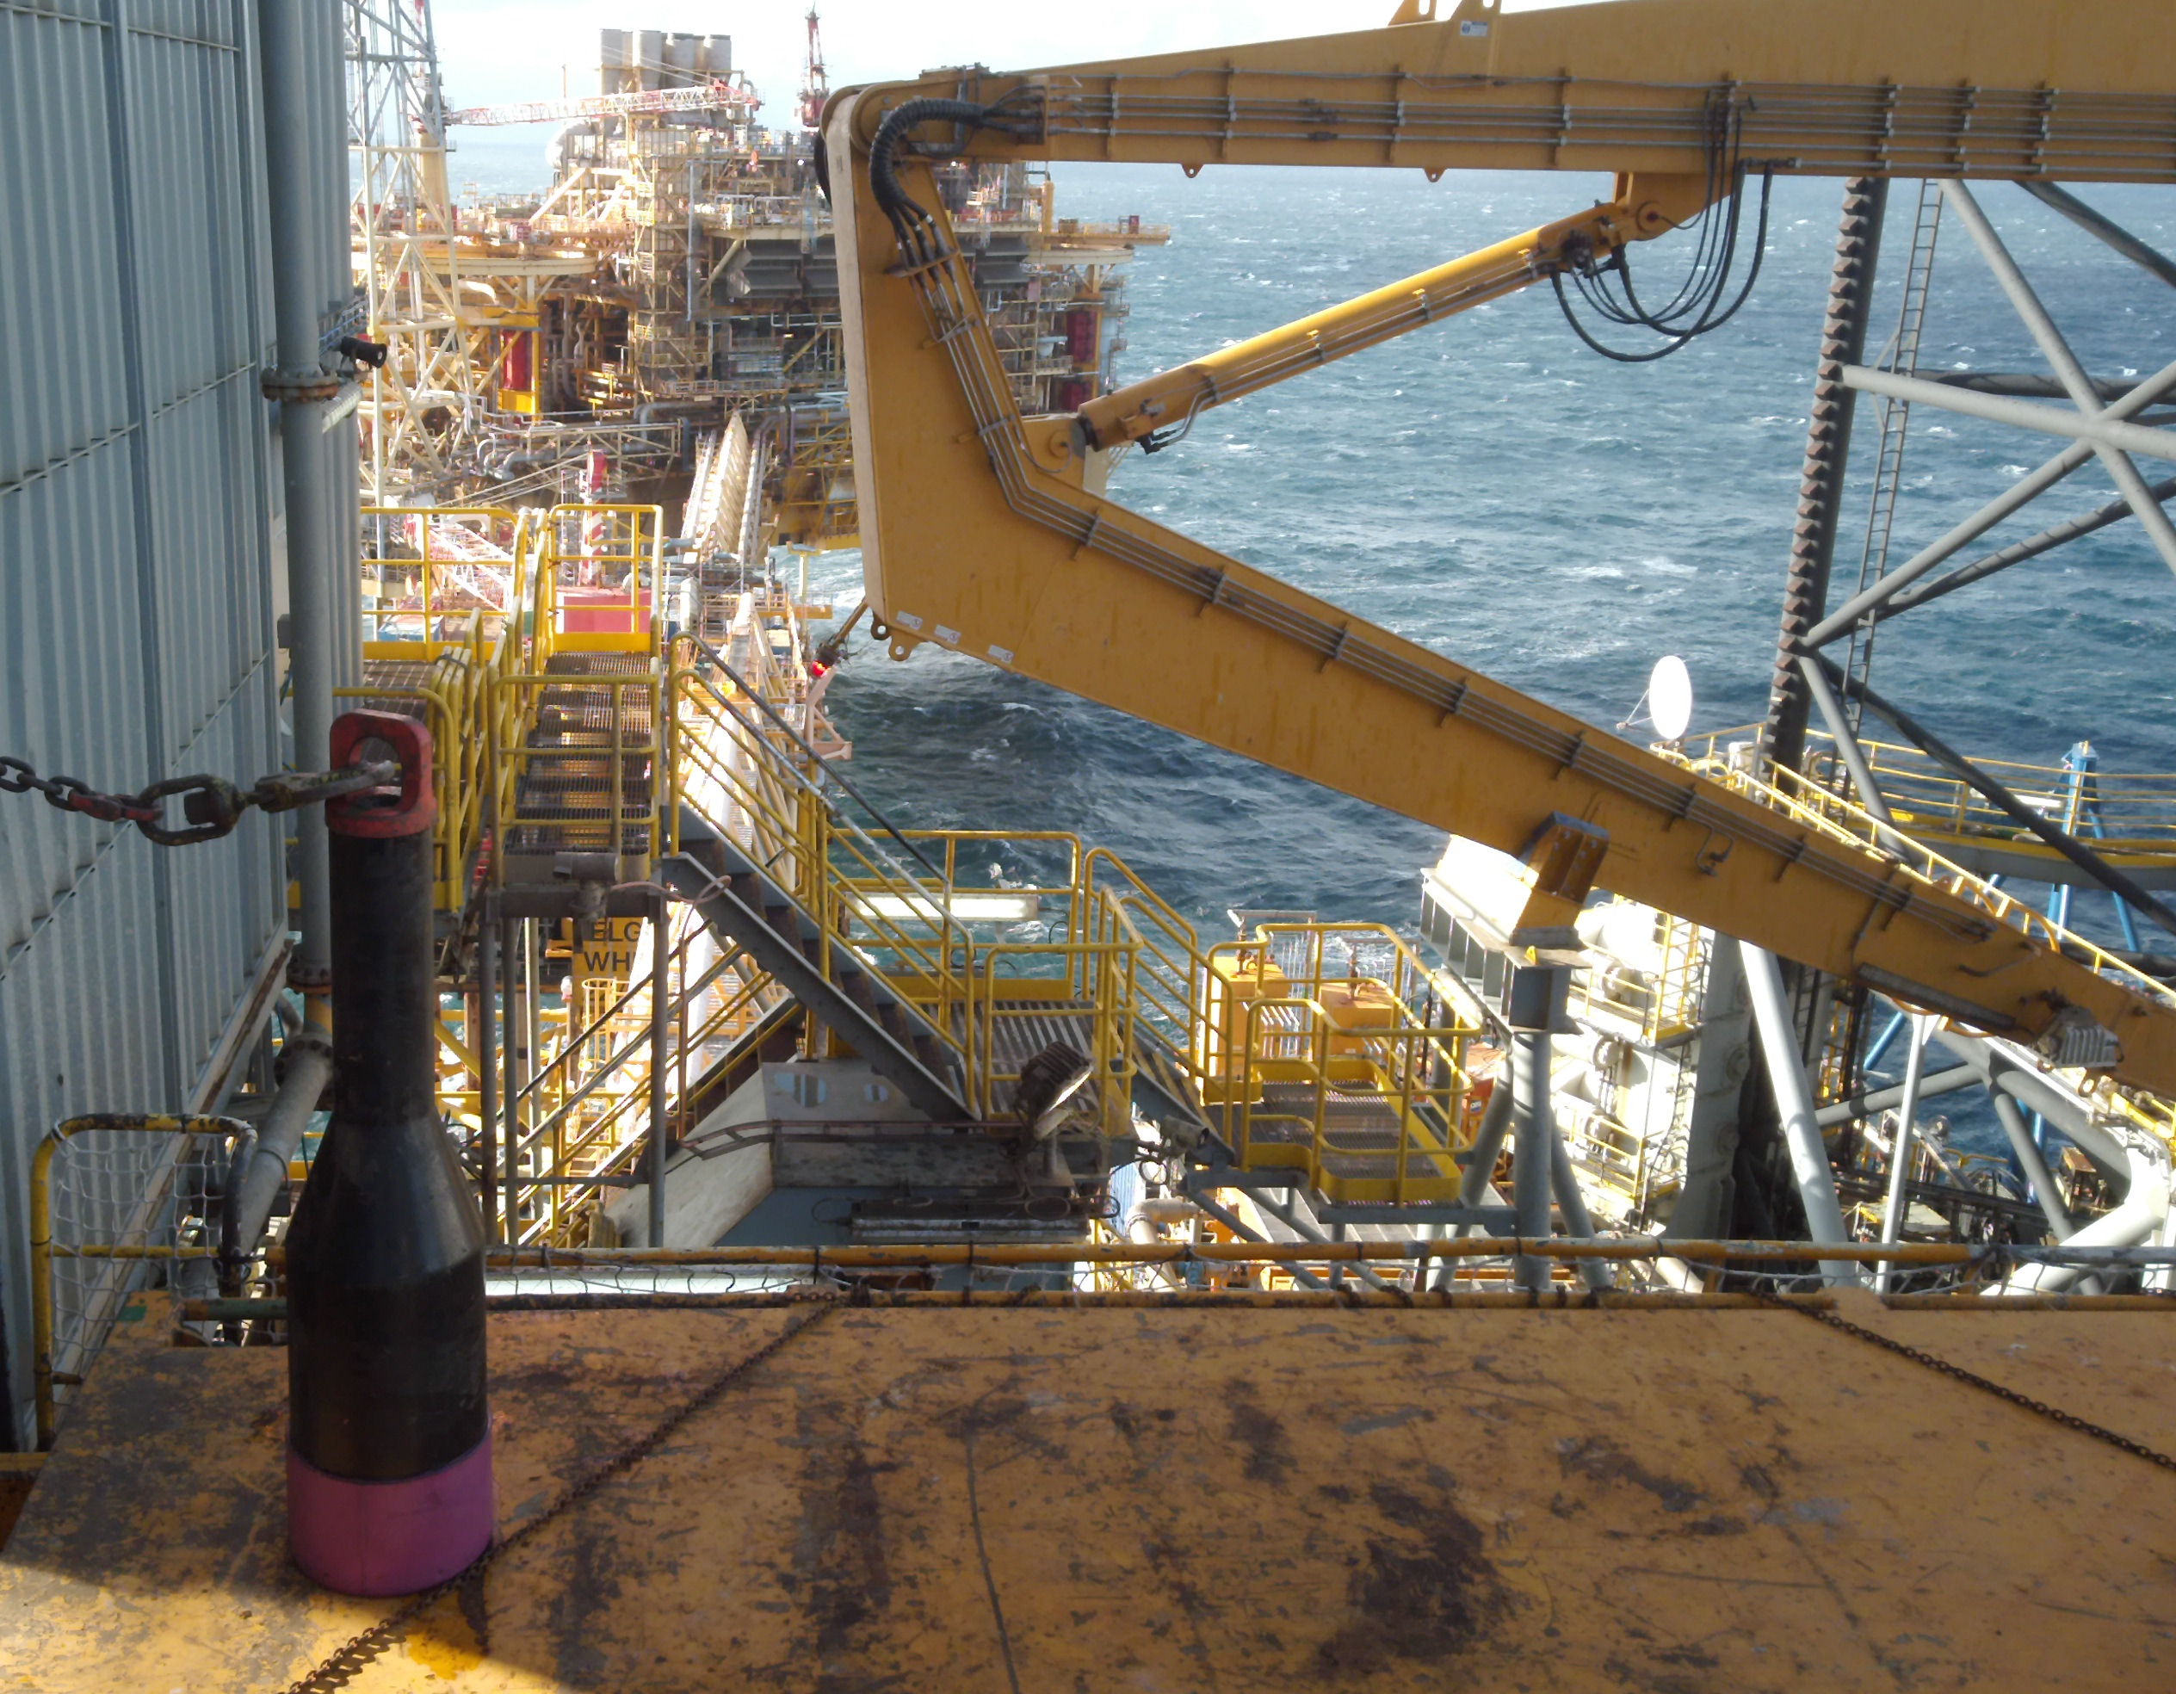
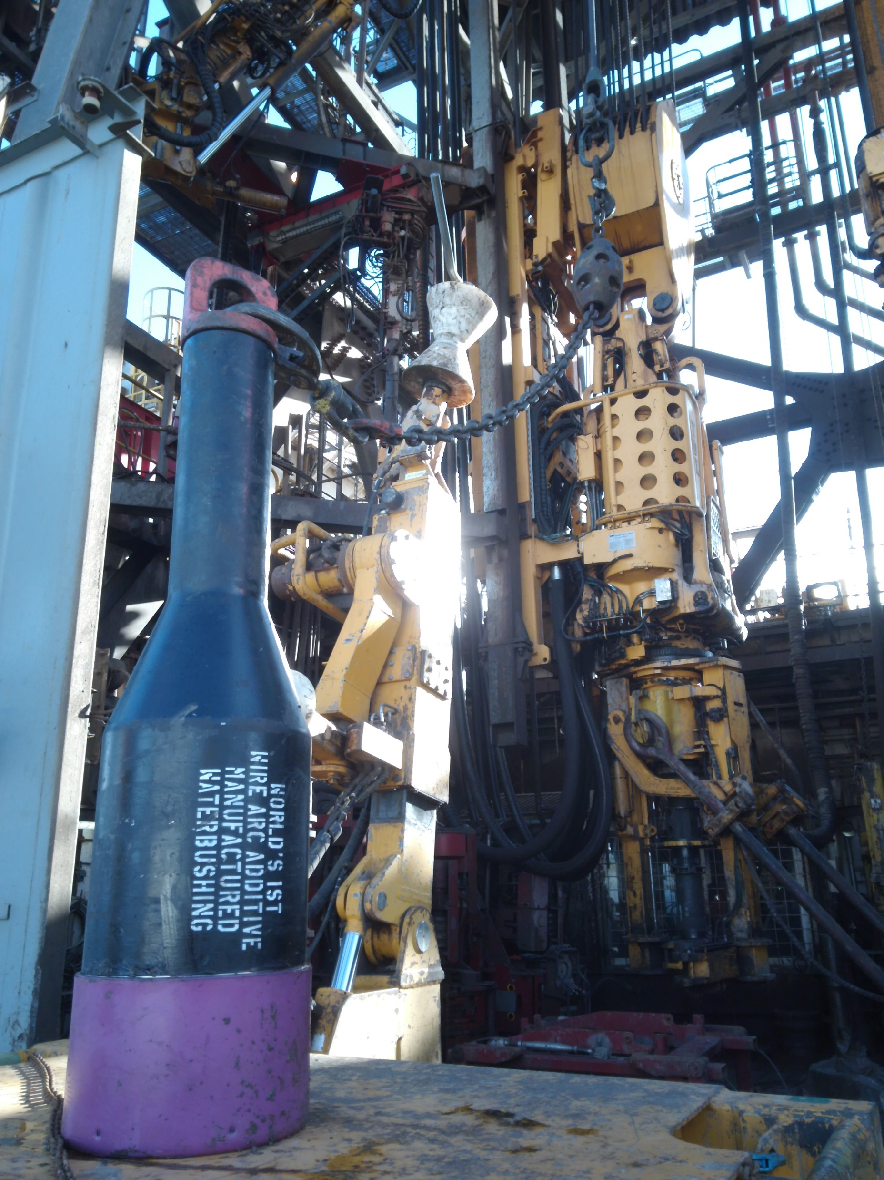
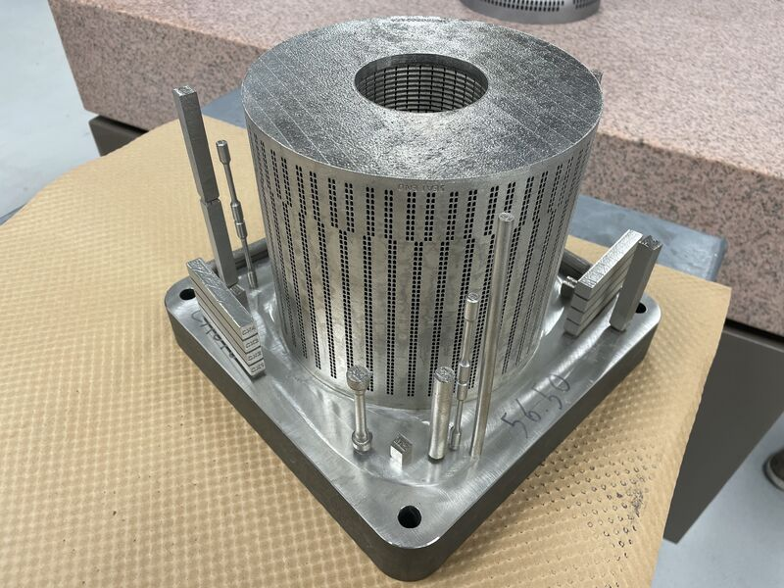
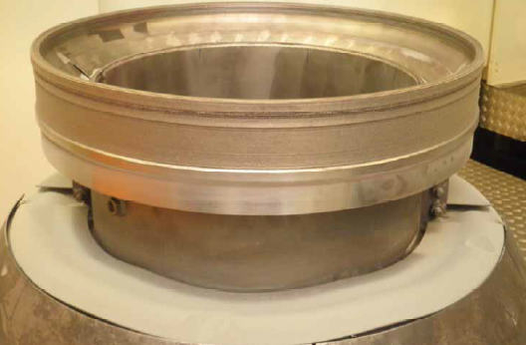
3D printed parts field deployed to date in the Oil&Gas industry
Pump impellers & inducers
> 100 field deployed
Low criticality parts
> 1000 field deployed
Before
1060 kg
365 kg
-56% weight
-1.2 ton CO2
(-45%)
After
500 kg
220 kg
6kpsi Well control accessory for running casing
2 printed (1 sacrificial) API 5CT & DNV ST-B203
Field deployed in UK February 2021
AM repair
> 100 completed
Control valve trims
> 30 field deployed
28

Slide 30
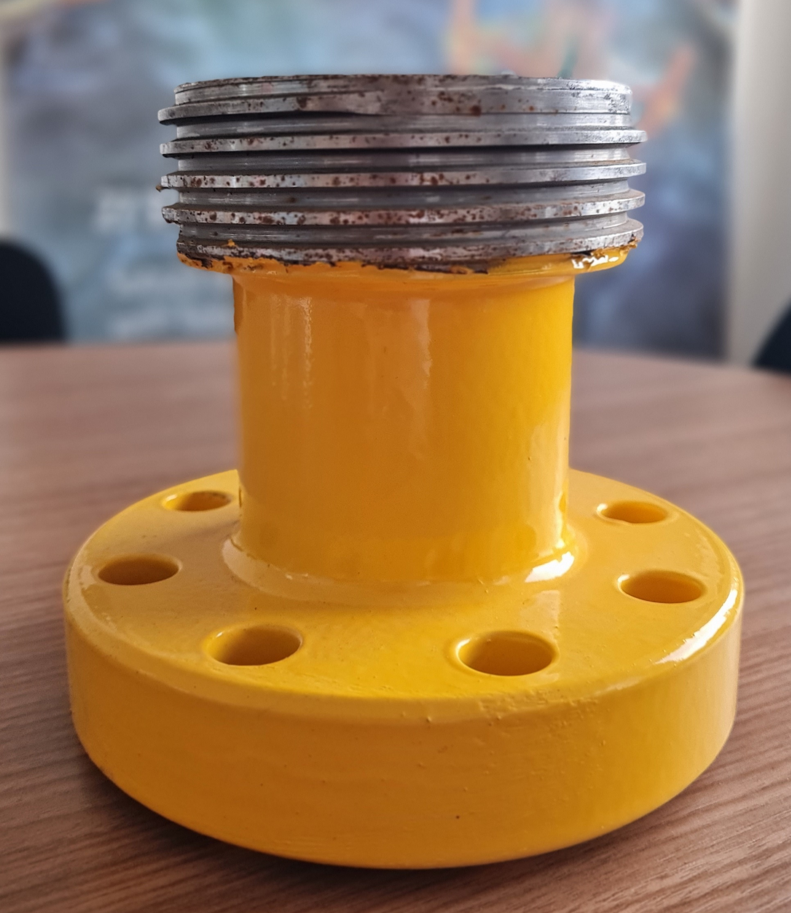
Africa – an exciting AM playground with big challenges and stakes
Angola
Produced water pump impeller
To be deployed end of 2022
5kpsi WECO crossover for well test / work-over
2 printed (1 sacrificial) API 6A & API 20S
To be field deployed in Congo June 2022
532 kbbl/d in 2021 (20%)
Hybrid LMD
WAAM
Nigeria – control valve cages
2 x 2nd stage water transfer pumps mini-flow line valve
1 x oil export pump liquid outlet let-down valve
BMD
Angola
Ultimakers +
Desktop Metal Studio system
50+ low criticality parts field-deployed
LPBF

Slide 31
Tilenga project – An opportunity to showcase the benefits of AM
The project in a nutshell
Partners : TotalEnergies (56.6%), CNOOC and UNOC
300+ wells to be drilled
Fluid separation & treatment plant in Kayseni
230 kbbl/d production capacity (Tilenga + Kingfisher)
Oil transported to Tanzanian port via 1443 km buried pipeline
The AM opportunity in Uganda
Landlocked country with limited industrial infrastructure
Spare parts to be transported overland from Kenyan port
Strong benefit of in-country 3D printing
The plan:
Screen spare parts recommended by OEMs
Find critical mass of parts to justify hardware investment
Put framework in place for multiple OEMs to share hardware

Slide 32
From a linear supply chain to an on-demand supply network
AM studio
3D scanning of parts
Generative design
3D design
IP Owners
Parts designers
Order liability
Deliver
Manufacturing monitoring
Remote Inspection and testing
Production quality control
Material traceability
3rd party certification
IP
3D Engineering
OEM Suppliers
Independant verifiers
Marketplace
Blockchain Transactions
Print / Manufacture parts
AM technologies
OEM or third parties
Local or regional
Parts selection
Place orders
Track and trace
Receive material
Use
Digital Inventory Platform
End Users
Factories
Parts selection software
Business IA
Category mgt & Optimization
Design consultancy
AI
ML
Logistics
Software providers

Slide 33
Energy focused Digital Inventory collaboration
First version of Digital Interface has been built and is being tested
Main challenges to be overcome are being tackled:
Pilots with OEMs ongoing, more to be kicked off in next phase of the project

Slide 35
Among the world’s TOP 5 in renewable energies by 2030

Slide 36
Worldwide: Carbon intensity (customer use of our products) -20% vs. 2015 Net Zero
Europe: Scope 3 (customer use of our products) -30% vs. 2015 Net Zero

Slide 37
CARLO DE BERNARDI
ORGANIZERS
SCIENTIFIC COMMITTEE
SME, Additive Manufacturing Industry Lead - ConocoPhillips
Additive Manufacturing
and Digital Inventory:
dreams or reality for the Energy sector?
IVS 2022
Technical Conference

Slide 38
Biography
Additive Manufacturing (3D printing) Industry lead with broad experience in technology transfer and implementation. Demonstrated track record of successful Company and Industry joint projects. Chairperson and active member of several technology technical committees. Valve SME/Consultant, valve critical applications, design, manufacturing and troubleshooting.
Active member of API SC6, SC20 and IOGP.
Chairman of API 20S

Slide 39
STEVE FREITAS
ORGANIZERS
SCIENTIFIC COMMITTEE
R&D Director at IMI CCI
Additive Manufacturing
and Digital Inventory:
dreams or reality for the Energy sector?
IVS 2022
Technical Conference

Slide 40
Biography
R&D leader with experience in creating new products and technologies for thermal power and oil and gas applications. Responsible for leading global R&D centers in US, Europe, and Asia; managing IP; and generating development roadmap. Enjoy working colleagues and customers around the world and finding creative technical solutions to challenging applications and field problems. Specialties: Severe service applications and problem solving in thermal power plants;
creating unique design solutions to improve performance and reduce cost.

Slide 41
IMI CCI and DRAG Multi-Stage Trim
IMI CCI provides specialized control valve designs that improve the reliability and efficiency of fossil, nuclear, and oil & gas facilities.
The IMI CCI DRAG™ design controls fluid velocities within the valve, and prevents problems with erosion, noise, and vibration.

Slide 42
Legacy manufacturing process
Two-dimensional flow paths are cut into plates to create disks
The disks are brazed or unitized into a disk stack assembly
Sizes from 6mm to 1000mm, materials include 316, 410, INC 718, and Tungsten Carbide.

Slide 43
LPBF development at IMI CCI
We began experiments with LPBF in 2008
Goal: improve flow control accuracy of small disk stacks
Process: design, build, and flow test
Results: did not always meet expectations
We found that we could not build legacy designs without re-engineering, and that we did not fully understand the process limitations.
We completed a comprehensive re-engineering for LPBF in 2017, and this produced a significant improvement in performance and quality.
We have shipped over 500 parts and are starting to phase out legacy process for many sizes.

Slide 44
AM technology for large disk stacks
IMI CCI produces UNS N07718 disk stacks for 600C in sizes ranging from 8” to 20”
We created a new design architecture for AM which reduced overall size by 25%
We validated the new design through CFD, flow testing, FEA, and load testing
We have several parts operating successfully in field.

Slide 45
Rotary DRAG with AM technology
The design takes full advantage of AM to produce a part that is geometrically complex but also strong and lightweight
24” 900CL valve with 18” x 8” x 8” AM part

Slide 46
IMI CCI Retrofit3D program
With AM, we are no longer restricted to making cylindrical disk stacks only for IMI CCI valves
This has been a transformative idea at IMI CCI, and we have built a new business unit around helping customers find flow control solutions with AM technology

Slide 47
PIETRO CASTELLI
ORGANIZERS
SCIENTIFIC COMMITTEE
Lead Design Engineer Additive Manufacturing at Baker Hughes
Additive Manufacturing
and Digital Inventory:
dreams or reality for the Energy sector?
IVS 2022
Technical Conference

Slide 48
Biography
Lead Design Engineer for Additive at Baker Hughes
Part of NTI Team (New Technology Introduction)
Expert in Additive Manufacturing for metallic and non-metallic
Leading AM projects in Bristol, Aberdeen, Houston, Florence
Passionate about Design for Additive and Generative Design

Slide 49
PANEL DISCUSSION
ORGANIZERS
SCIENTIFIC COMMITTEE
Technology Providers
Desktop Metal – EOS – Roboze – Velo3D
IVS 2022
Technical Conference

